Slide 1
UA9-LHC @ LAL
Alessandro variola, lal - in2p3 – cnrs
Thanks to T.Demma, L.Burmistov
UA9 is the crystal-assisted collimation experiment at CERN.
The aim of this experiment is to demonstrate that bent crystals can work as a “smart deflector” on primary halo particles. The final goal is to use this technique for LHC collimation.
After some years of successful operation in the CERN-SPS, the UA9 experiment was installed in the LHC collimation system in March 2014.
Outlook:
Impact on the choice of the future LHC collimation system
Acquiring competences in crystals, tracking, impedance measurements…
LAL Accelerators and Detectors Expertise

Slide 2
UA9 – At present : Multi stage collimation in LHC
The halo particles are removed by a cascade of amorphous targets:
Primary and secondary collimators intercept the diffusive primary halo.
Particles are repeatedly deflected by Multiple Coulomb Scattering also producing hadronic showers that is the secondary halo
Particles are finally stopped in the absorber
Masks protect the sensitive devices from tertiary halo
beam core
0
primary halo
6
secondary halo
& showers
6.2
7
secondary halo
& showers
primary collimator
0.6 m CFC
secondary collimator
1m CFC
secondary collimator
1m CFC
10
Normalizes aperture [σ]
tertiary collimator
absorber 1m W
tertiary halo
& showers
>10
Sensitive devices
(ARC, IR QUADS..)
masks
Collimation efficiency in LHC ≅ 99.98% @ 3.5 TeV
  Probably not enough in view of a luminosity upgrade
  Basic limitation of the amorphous collimation system
    p: single diffractive scattering
    ions: fragmentation and EM dissociation

Slide 3
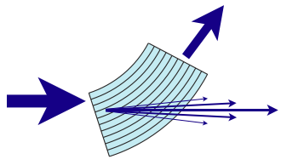
UA9 - Crystal assisted collimation
Bent crystals work as a “smart deflectors” on primary halo particles
Coherent particle-crystal interactions impart large deflection angle that minimize the escaping particle rate and improve the collimation efficiency
θ_{ch} ≅ α_{bending}
1 m CFC
3 mm si
amorphous
channeling
<θ>_{MCS}≅3.6μrad @ 7 TeV
θ_{optimal @7TeV}≅ 40 μrad
beam core
0
primary halo
6
Multiple Coulomb scattered halo (multi-turn halo)
6.2
7
Dechanneled particles in the crystal volume
Deflected halo beam
10
Normalizes aperture [σ]
Silicon bent crystal
secondary halo
& showers
>10
primary collimator
0.6 m CFC
absorber
1m W
Sensitive devices
(ARC, IR QUADS..)
secondary collimator
1m CFC
secondary collimator
1m CFC
masks
Collimators partially retracted
Absorber retracted

Slide 4
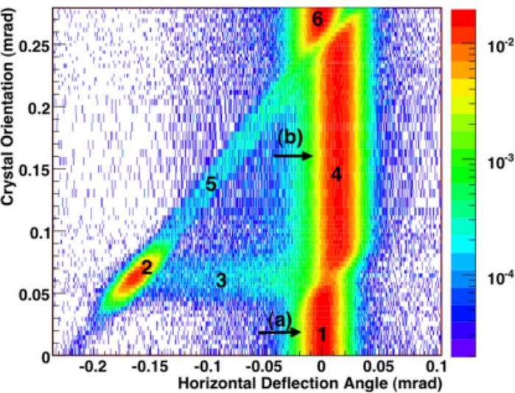
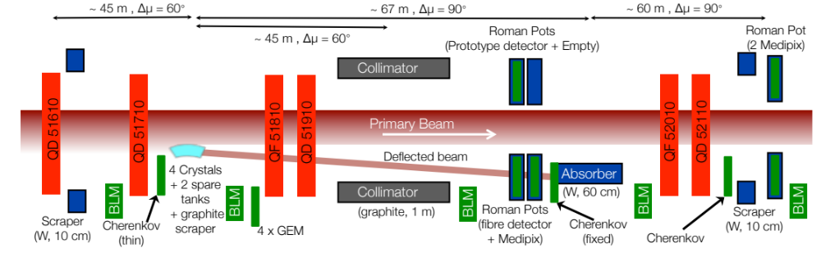
UA9 @ LAL/DEPAC
Crystal Deflected Beam Intensity Scan*
Present Layout in the SPS
*W. Scandale et al., Phys. Rev. Lett. 98, 154801 (2007)
Grouping different competences, a team of 7 people from the LAL Accelerator Department recently joined the UA9 collaboration and is involved on several subjects:
  Nonlinear tracking simulation of halo particle in the presence of the bent crystal;
  Data analysis from previous and foreseen experiments both in SPS and LHC;
  Characterization of the coupling impedance of the experimental setup and its influence on beam dynamics for both SPS and LHC;
  Study and mitigation of the observed electron cloud induced effects in the SPS.

Slide 5
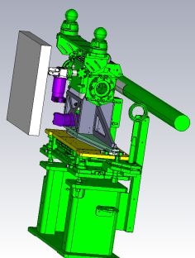
Coupling Impedance Studies for UA9 (in Collaboration with A. Danisi CERN)
Characterization and optimization of the coupling impedance of the UA9 component planned for installation in SPS and LHC:
  Simulations using dedicated finite elements based codes
  Bench measurements
Measurements performed on the LHC goniometer Tank
Installation of a dedicated measurement bench at CERN. New method using a waveguide instead of a wire. Collaboration with INFN Naples. At the end the bench will be integrated in LAL.
Final disign of the goniometer tank installed in the LHC collimation system
When the cylinder is in position, the first peaks are at high frequency (>2.2 GHz)
‘’Beam View’’ of the UA9 goniometer installed in LHC

Slide 6
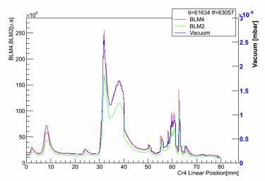
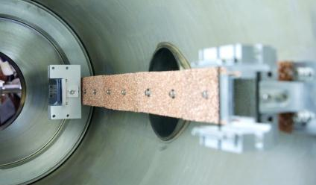
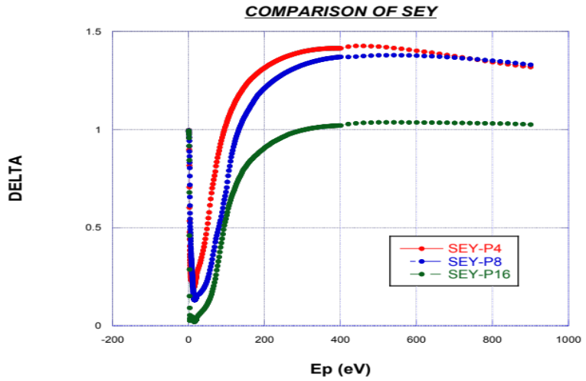
e⁻ cloud Studies for UA9 (in Collaboration with CERN AB-BP group and R. Cimino INFN-LNF)
Anomalous vacuum pressure rise and beam losses as a function of the goniometer position
Evidences of the formation of an e-cloud observed in the goniometer installation region during 25 ns operation in the SPS
Countermeasures adopted:
  Solenoid winding
  Cu foam coating of the goniometer Al bar in order to reduce the SEY
Detailed simulations undergoing
Measurments expected by the end of 2014
New technology: Coated Al bar installed in the SPS (Y. Gavrikov, CERN)
Measured SEY of Cu Foam samples (R. Cimino, INFN/CERN)

Slide 7
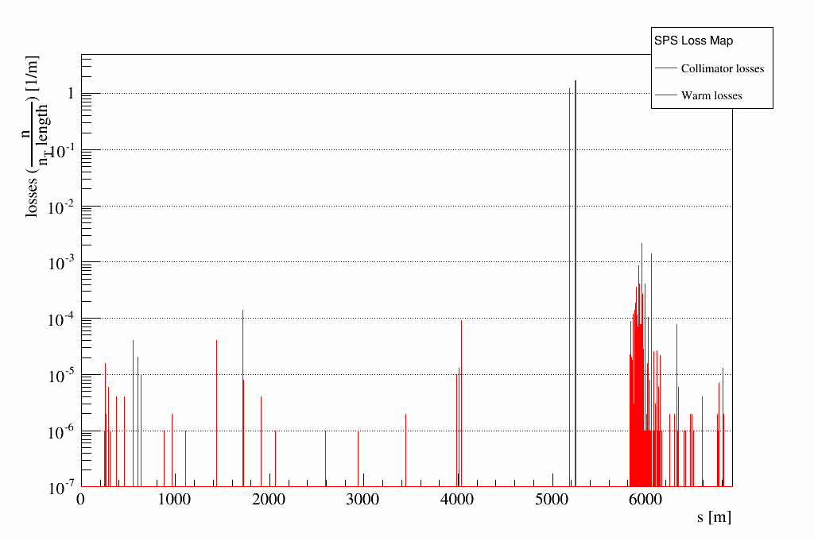
Tracking Simulations for SPS (S. Chancé in collaboration with D. Mirarchi (CERN))
UA9 collaboration has already performed some experiments on SPS from 2009 to 2013.
Crystal has been added to the SixTrack simulation code.
Tracking simulations on many turns taking into account the particles absorbed in the crystal and other collimators in order to produce loss maps for different crystal configurations.
Goals:
  Assess crystal collimation efficiency
  Benchmark crystal and tracking routines with SPS data
  Optimize crystal parameters (e.g. locations, angles..)
  Acquiring a unique expertise in particle –crystal interaction in an accelerator environment !!!!
SPS LossMap obtained with SixTrack including the effect of the crystal. In black are reported the losses in the collimation system, in red losses in the ’’warm’’ regions of the machine

Slide 8
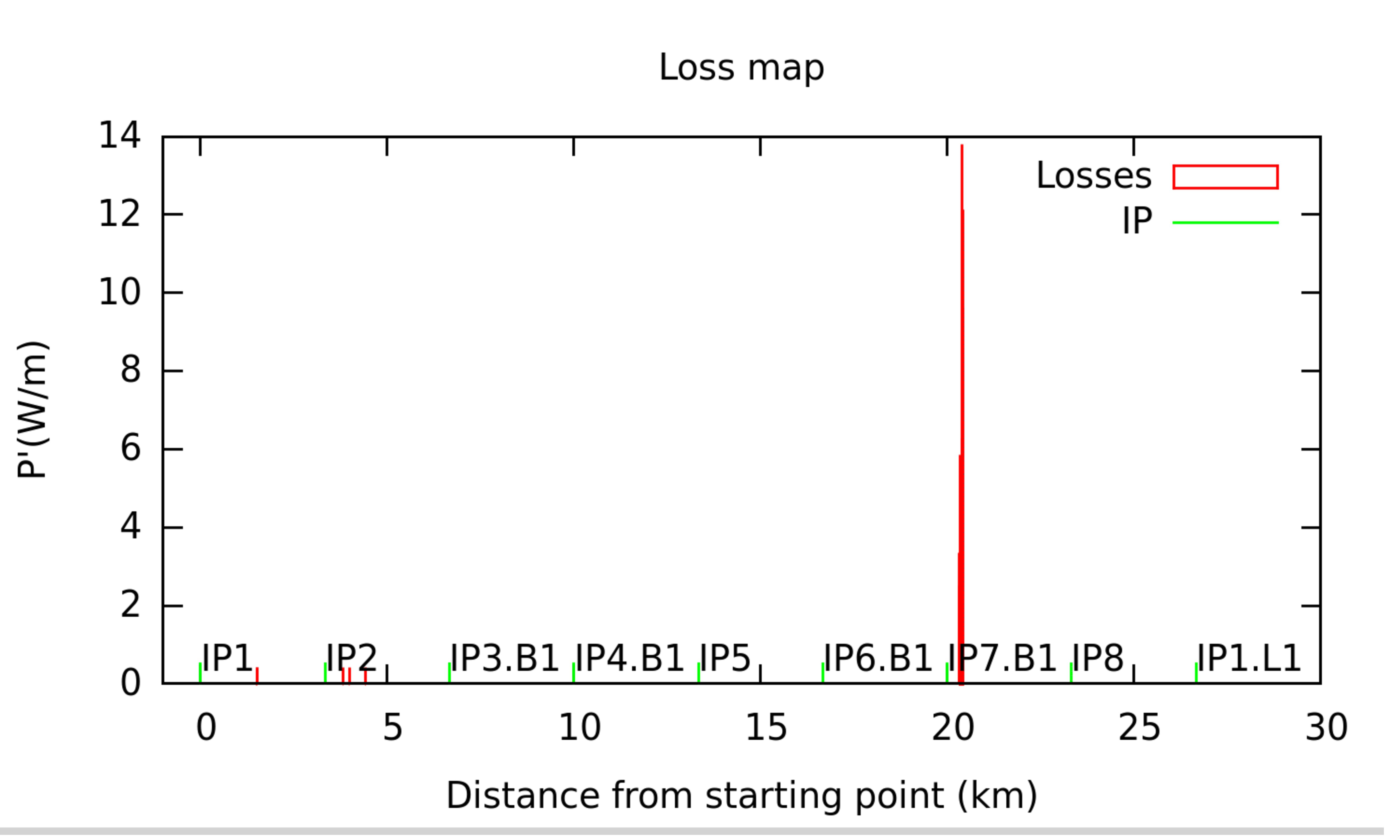
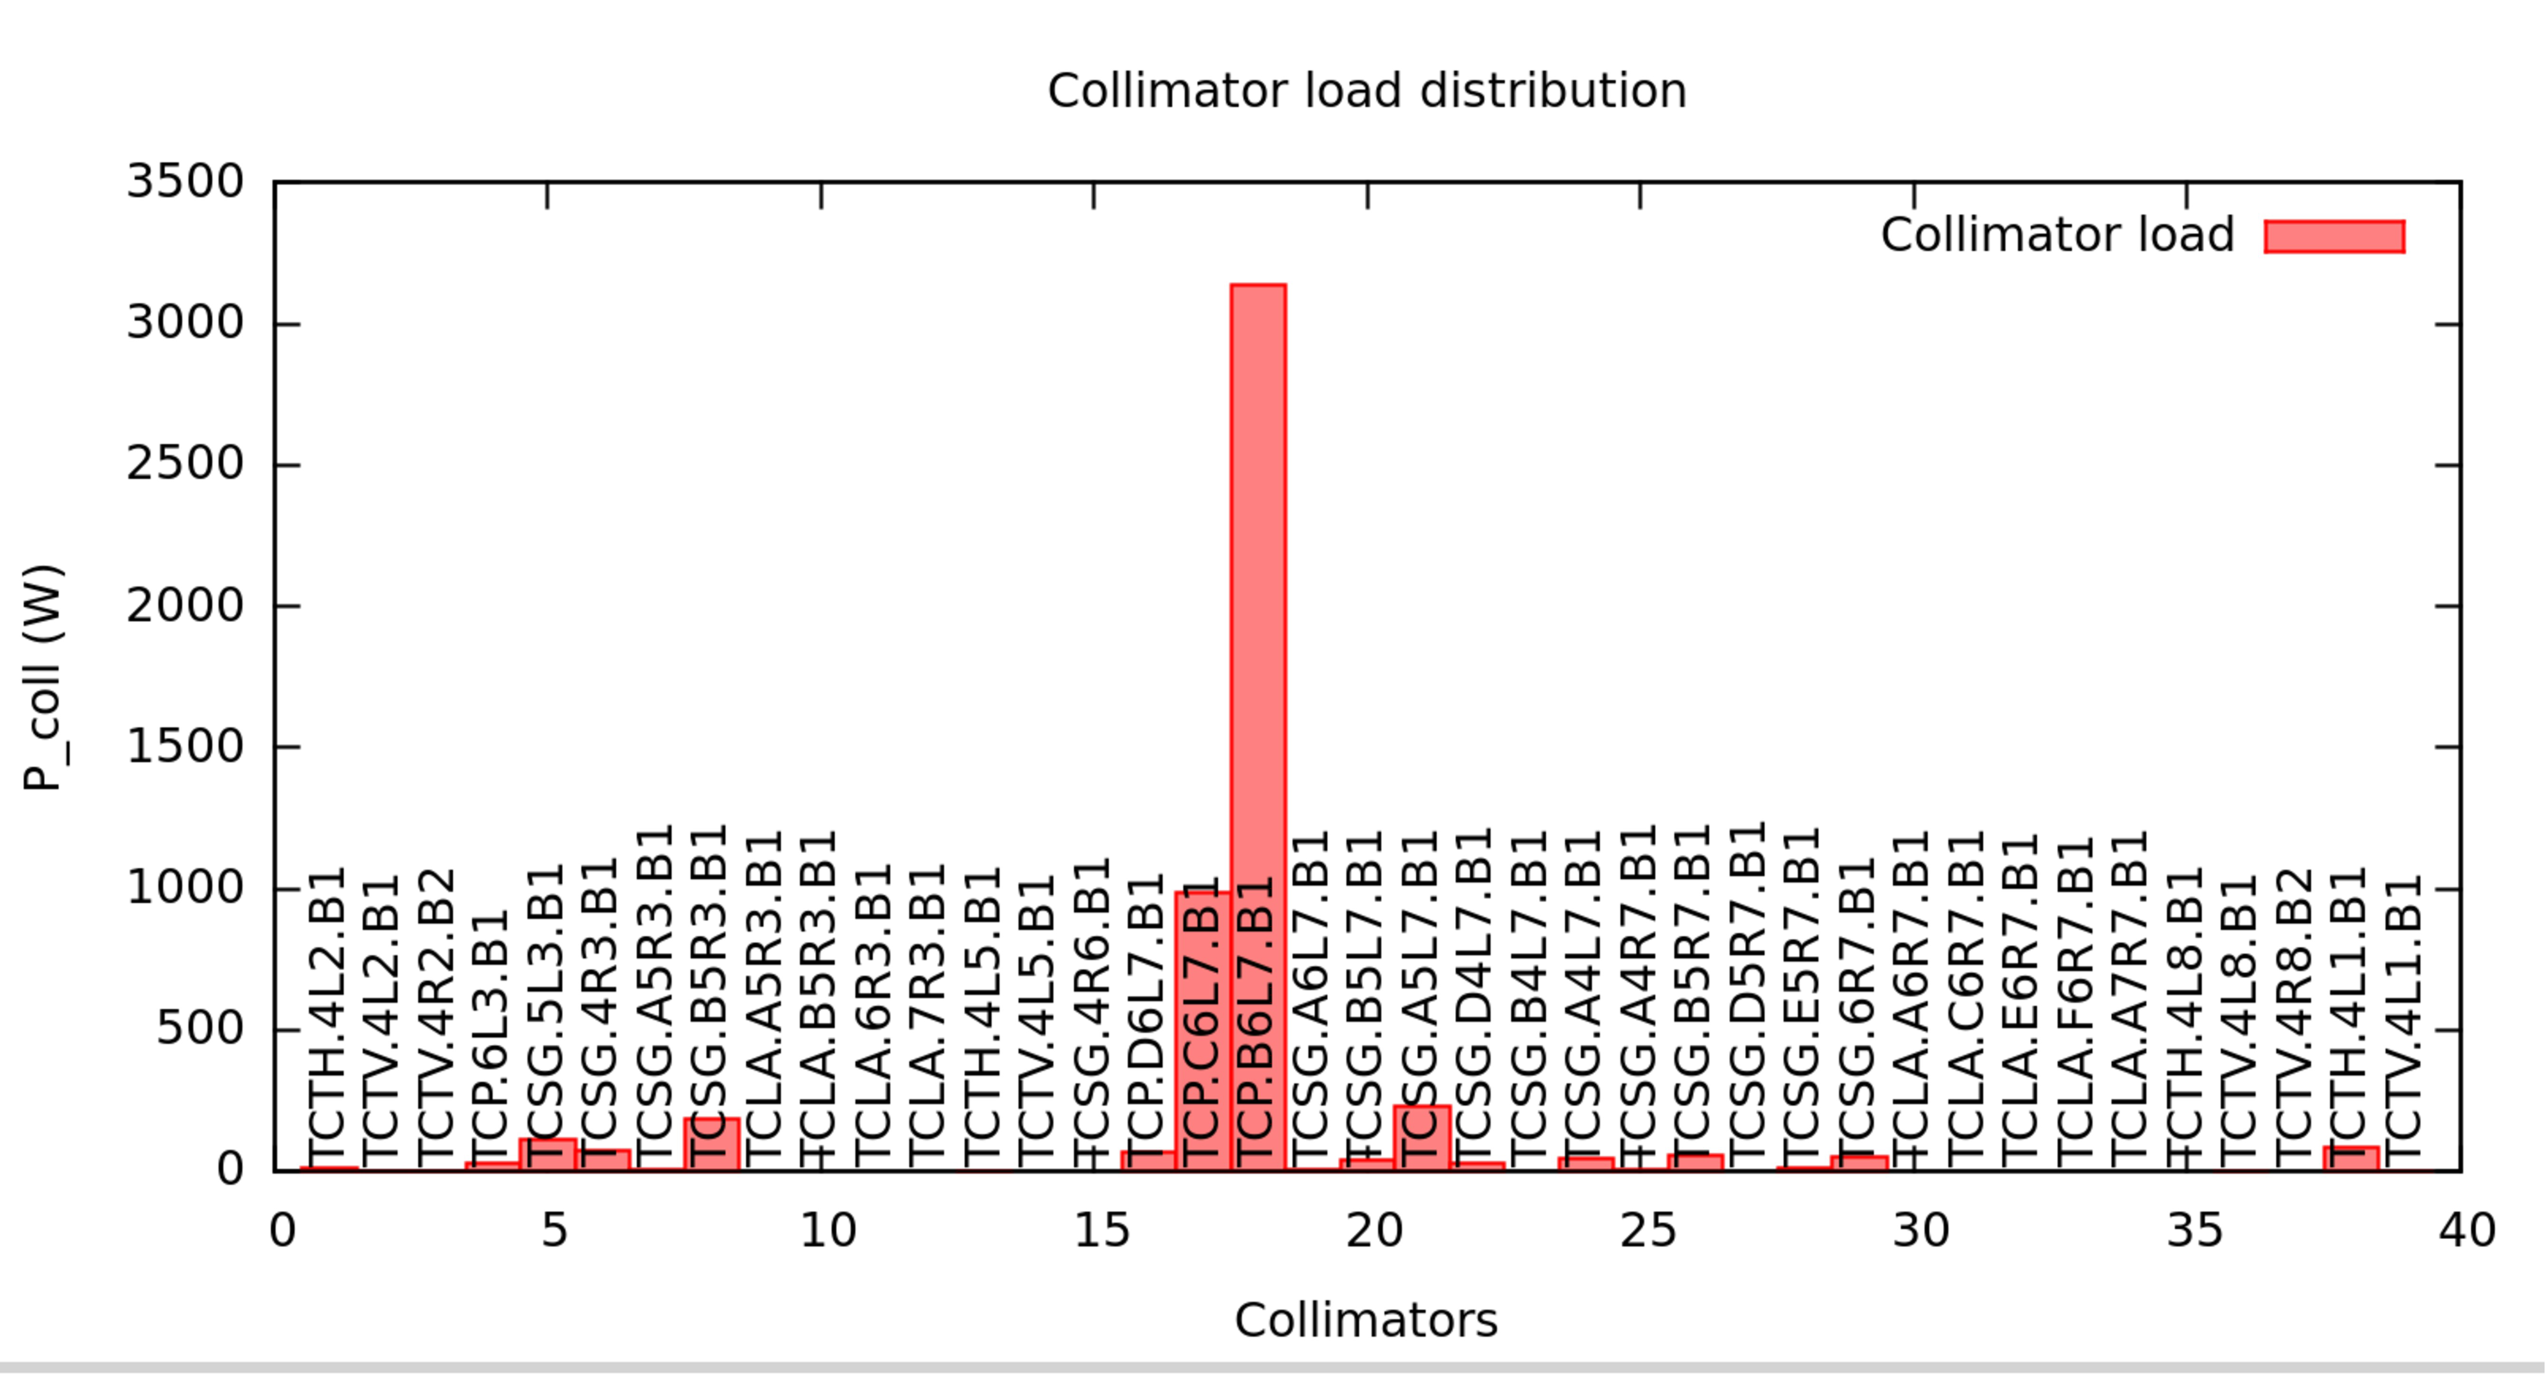
Ion Tracking in SPS and LHC (J. Zahng)
Improvement of the ICOSIM++ code developed at CERN to track particles through a storage ring taking into accounts interaction of heavy ions with the collimation system.
Goals:
  Inclusion of a ‘’realistic’’ model of the particle crystal interaction
  Benchmark with other existing routines and real data
  Optimization of the crystal collimation system
  Analysis of foreseen experimental run
  First ion-crystal simulation in a machine!!!
Examples of Loss maps obtained for Pb ions and standard LHC collimation System

Slide 9

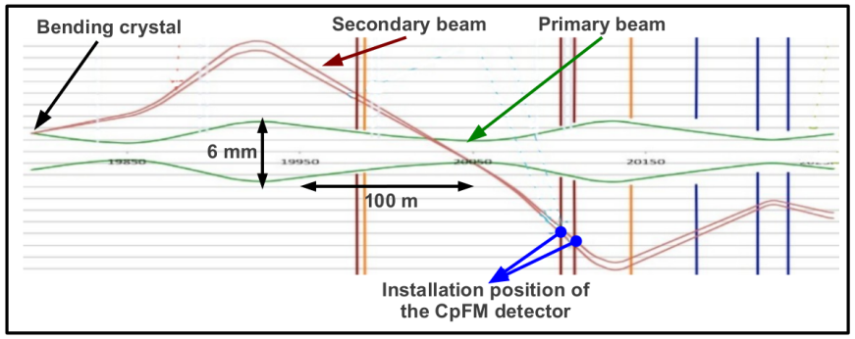
Use bent crystal at LHC as a primary collimator. DETECTORS
LHC beam pipe (primary vacuum)
Contribution of the LAL GRED group
Aim: count the number of protons with a precision of about 5-10 % (for 100 incoming protons).
Main constrains for such device:
No degassing materials (inside the primary vacuum).
Radiation hardness of the detection chain (very hostile radioactive environment).
Compact radiator inside the beam pipe (small place available)
Readout electronics at 300 m
Cherenkov detector for proton Flux Measurements (CpFM)

Slide 10
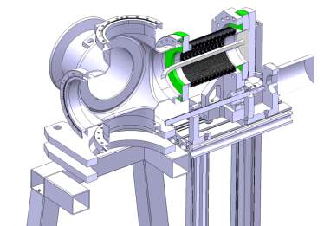
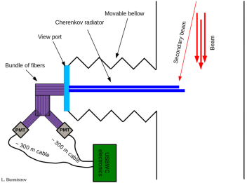
CpFM detection chain components
Tank
Bellow
Radiator
Radiation hard quartz radiator
The flange with view port attached to the movable bellow.
The light will propagate inside the radiator and will then be transmitted to the PMT via a bundle of optical fibers (as well radiation hard).
300 m low attenuation electrical (LHC compatible) cable.
USB-WC electronics. For more details see :
USING ULTRA FAST ANALOG MEMORIES FOR FAST PHOTO-DETECTOR READOUT,
(D. Breton et al. PhotoDet 2012, LAL Orsay)

Slide 11
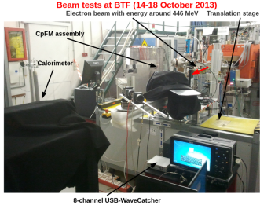
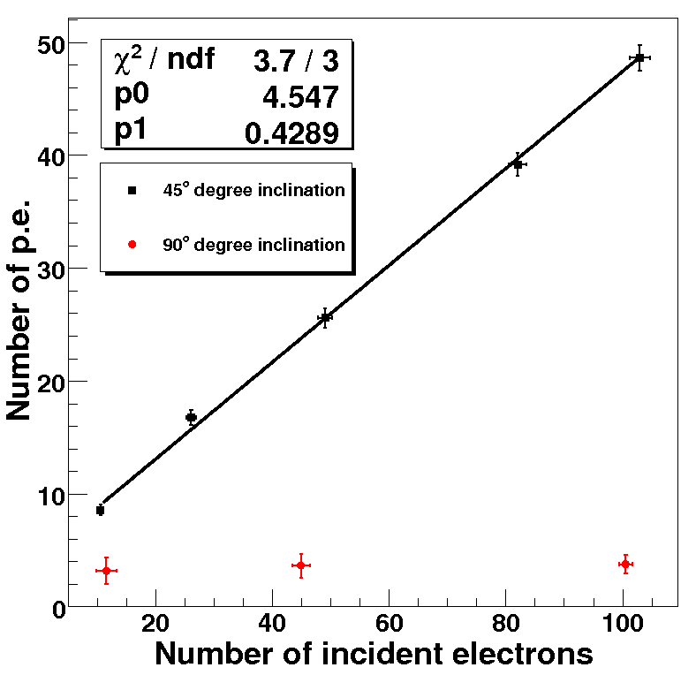
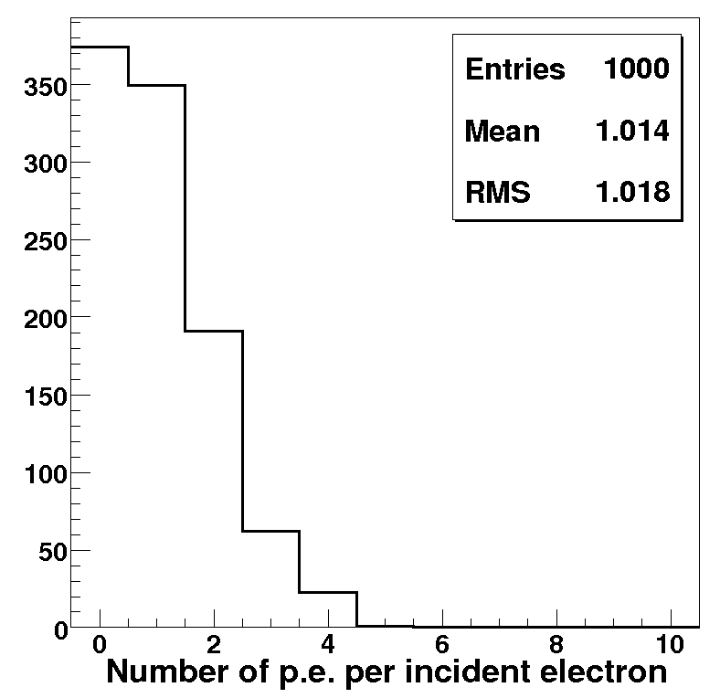
Pioneer test at Beam Test Facility (Frascaty, Italy) in October 2013
We construct very first prototype of the CpFM
This prototype has been successfully tested with cosmic mouns at CORTO (COsmic Ray Telescope at Orsay)
We perform test with 500 MeV/c electrons at BTF in October 2013.
Main principles has been proved. Measurements are compatible with simulations*.
Results has been presented at IEEE – 2013, Seoul conference
We start to construct the base line option for the CpFM detector.
Measurements
Simulation
We detect 0.43 p.e. per incident electron
* The difference between simulations and measurements (factor of two) are due to poor quality of home made fiber bundle.

Slide 12
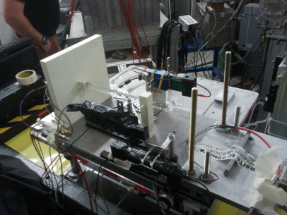
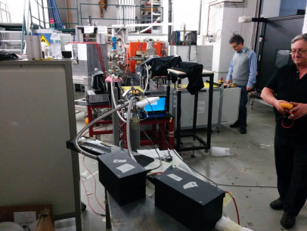
Test at BTF (April 2014) of the real size CpFM detector chain
Quartz radiator
Boxes with PMT
Quartz/quartz (cor./clad.) bundle
of 4 m long
Full size CpFM detector with 4 m long optical bundle of fibers has been been tested with 500 MeV/c electrons at BTF.
Preliminary results
Preliminary results shows possibility to use this kind of detector for proton counting at LHC.
Precise data analysis is ongoing.

Slide 13
CONCLUSIONS
UA9 LHC. Strategic experiment in the framework of the LHC upgrade
LAL participation in accelerator science and detectors
Acquiring unique expertise in :
-Crystal channeling and collimation
-Impedance measurements and characterization
-Vacuum chamber treatment for e- cloud
-Modeling and tracking (protons and IONS!!!)
-Detectors => Recognized center for Cerenkov detectors.
-In vacuum Cerenkov Roman Pot

