Slide 1


Laboratoire Leprince-Ringuet (LLR)
-------------------------------------------------
LLRにようこそ
OUTLINE
Very short presentation of LLR, including our collaborations with Japan
Presentation of the CILEX –Apolon project

Slide 2
LLR : Living in a different world than LAL or IRFU-CEA …
… former director of LLR said « to be a pilot fish for them»
LLR is the bridge between the world of basic science (astrophysics, colliders High Energy Physics, etc..)
and the world of « Grandes Ecoles » (high technology, industry, large group managers. i.e. Carlos Ghosn from Renault-Nissan)
« Grandes Ecoles » means tight selection for students. Same situation than for example MIT, Caltech or Stanford
Good illustration for High Energy Physics
A joint Master program with ETH-Zurich !!! → High level students → Excellent physicists
(co-responsible of the master with resp. of Theoretical physics at CERN)
Another illustration for HEP
At LLR
  2014 CNRS silver medal for nuclear, particle and astroparticle physics (only 1/year at IN2P3)
  Responsible for CMS-LHC in France
  Responsible for CALICE – ILC in France (was spokesperson of CALICE)
  Responsible for T2K -IN2P3-France
  Deputy Spokesperson of HESS ground telescope
  Member of SPSC
  Member of LHCC

Slide 3
Elementary Particle Physics
For very long time , particle physics was based on complementarity between
proton machines and electron machines (SPPC-CERN, SLC-Stanford, Tevatron, LEP, Tevatron-run2, LHC , …)
ELECTRONS machines
Too early for laser acceleration (See next presentation by Arnd Specka)
Too early ALSO for FCC (future Circular Collider). It is just a concept, not a machine project…(costing, advanced technical design, etc..)
Today, the community consider ILC as The Next Machine …….. Coll. With Kyushu Univ. , ICEPP/Tokyo univ. , Shinshu univ
PROTONS machines
CERN LHC CMS (up to 2025) (including Heavy Ions Physics)
CERN LHC High Luminosity (up to 2035)
FCC – LHC at 50/100 TeV (after 2035)
Fixed target
T2K (up to 2025) - Coll. With Japanese groups (Kyoto) on INGRID
LBNO(E)
Physics Now
R&D for short/midterm development
R&D and infrastructure for long term development

Slide 4
HE Gamma Astronomy (study of violent events of the universe)
For very long time , complementarity between space and ground astronomy
SPACE astronomy
FERMI Nasa – new view of universe
HARPO R&D project (A TPC for polarimetry and energy/direction of photons ) ……. Coll. With LASTI- Hyôgo University
Ground astronomy
HESS in Namibia.
Large array of telescopes (about 60) … project CTA – Competition with Japanese groups on Mid size telescope
Physics Now
R&D for short/midterm development
R&D and infrastructure for long term development

Slide 5
Scientific Activites
Energy Frontier
CMS on LHC – CERN
  Detector for ILC – (with Japanese groups)
  Project HGCAL on CMS for HL-LHC
Intensity Frontier
  CMS Heavy Ions on LHC – CERN
  T2K – JPARC – Japan
  Fixed target at CERN on HI
  Preparation of LBNO(E)
Astrophysics
HE gamma Astronomy - space and ground
  Fermi NASA space telescope
  HESS – Ground array of telescope
Future on CTA
Multi – disciplinary physics
  MEDICAL Application
  (European reference on beam profiler for
  for hadron therapy machine )
  GEANT4 - simulation
  (simulation of interaction with matter)
CILEX-GALOP
(Long Focal Area – electron acceleration
with laser-plasma)

Slide 6
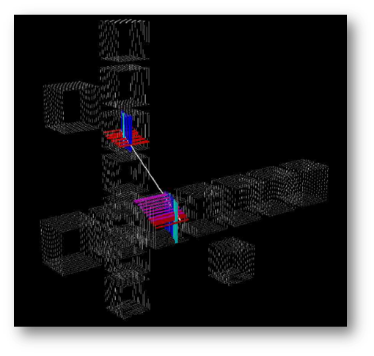
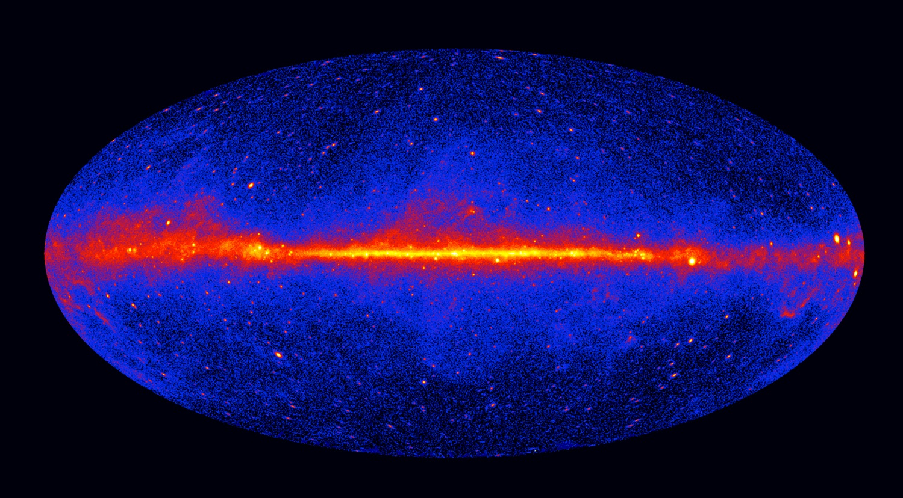
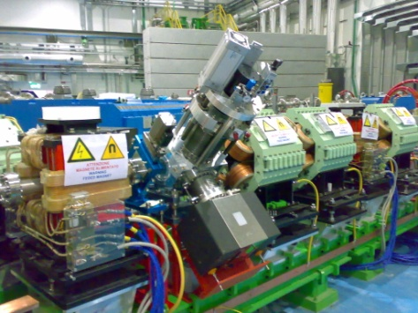
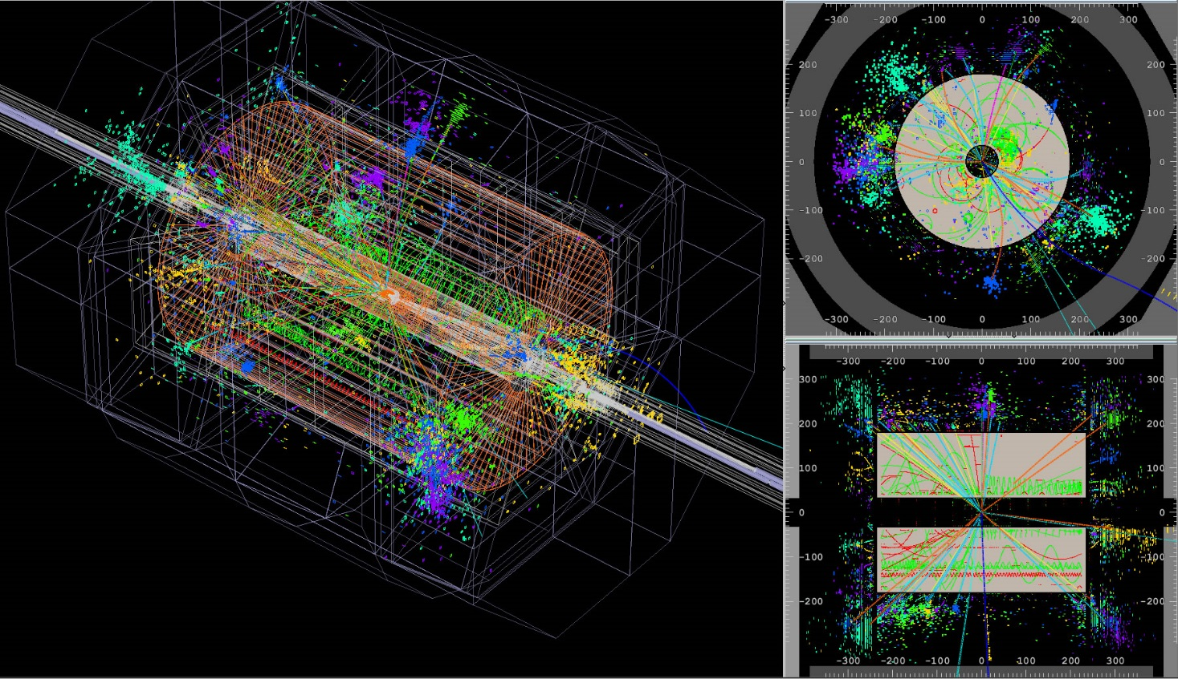
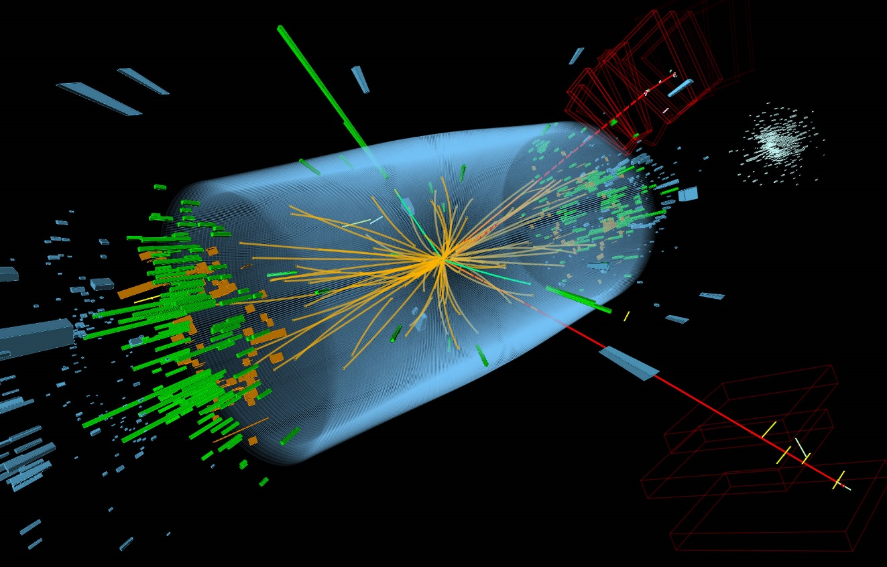
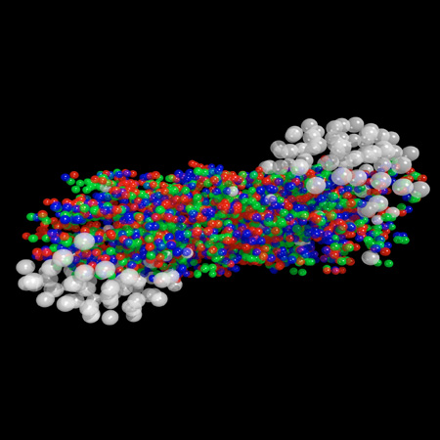
T2K
simulation
FERMI
GeV sky
Italian machine
for Hadrontherapy
CNAO
beam profilers
Heavy Ions
simulation
CMS
LHC data ZZ
ILD sim

Slide 7
ILLUSTRATION of collaboration with Japanese groups

Slide 8

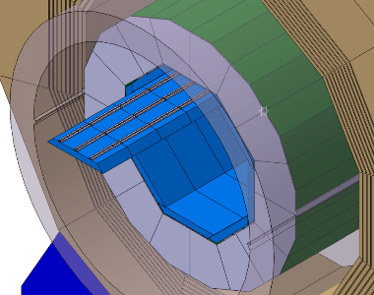
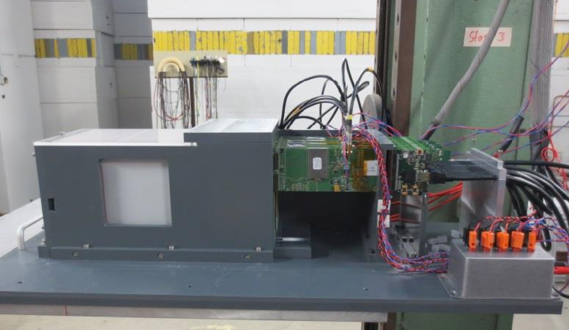
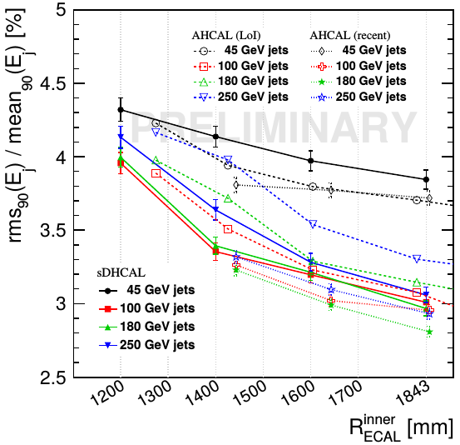
LLR - RCAPP, Kyushu Uni - ICEPP, Tokyo Uni
Silicon-Tungsten (SiW) ILD ECAL collaboration
2 ILD ECAL + 2 CALICE meetings / year,
remote meetings / 1-2 weeks
MoU btw CNRS and Kyushu for sensor R&D in Hamamatsu.
MoU btw LLR and Kyushu on SiW R&D. LLR (leader of SiW project) has sent to Kyushu fully functional prototype, transferred technological knowledge.
Recent interest to SiW technology for CMS endcap Phase 2 upgrade (HGCAL) and for future circular colliders (TLEP, CEPC).
Physical prototype (2005-2011) – PFA proof
Technological prototype (2012-present):
charge injection + cosmic + laser calibration, 4 tests @DESY 1-5 GeV e-beam
2015: test 3/5 x ILD barrel module @CERN
Strong
Interaction
with
Hamamatsu
Photonics
R&D program
Optimization (Tokyo, LLR)
Optimize performance vs cost as a function of ILD dimensions,
N ECAL layers, thickness, affordable fraction of dead pixels/chips,
Si dead area, etc. One result: ILD reconsiders ECAL baseline R:
1.843 →1.5 m (1.5⁻¹ lower price)

Slide 9
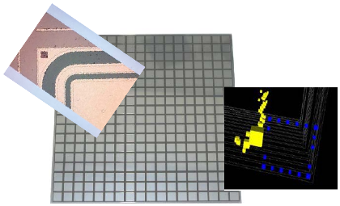
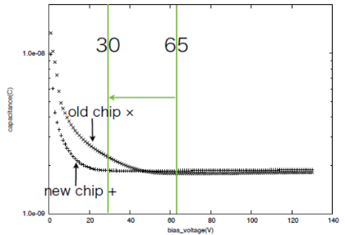
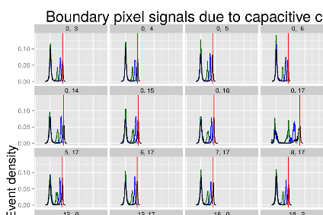
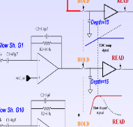
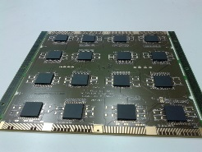
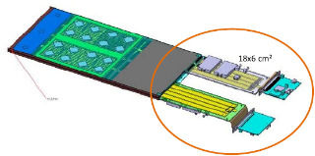
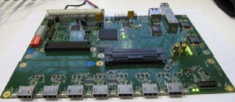
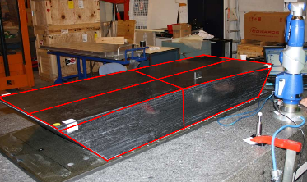
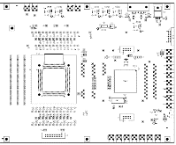

2. Silicon sensors (Kyushu, LLR)
- Test different HPK designs: C-V, I-V.
- Laser tests: xtalk via GR.
- Plan: Irradiation tests (γ,n) (also Tokyo)
3. DAQ electronics (Kyushu, LLR)
- FE chip SKIROC2 developed by
Ω group (Ecole polytechnique)
- 3 new PCBs, design+industrial production
a) with sensor and FE chips
b) clock+voltage distribution
c) Gigabit Data Concentrator Card
- Ω test board for FE chip
4. Mechanics (LLR)
- 3/5 x ILD module ready (600 kg, 5 years R&D)
5. Software development (Kyushu, Tokyo, LLR)
- DAQ software, tools for online/offline data analysis
- Plan: debugging tools, adaptation to larger DAQ, integration w/other detectors
6. Analysis (Kyushu, Tokyo, LLR)
- Physics proto FNAL'2008 corrections, E resolution, - DESY'13 beam data,
- PANDORA, GARLIC PFA reco w/data and MC, - cosmic, Q injection calib/xtalk
C-V, promising design wo/GR
Laser signals
a) FEV9-10
b) SMB3->4 serves 1->8 FEVs
SKIROC2
QFP->BGA, x4 chan.
c) GDCC
sends data to PC
Ω test board
w/analog outputs
QFP->BGA
replace old FPGA

Slide 10
Now
CILEX - GALOP

Slide 11
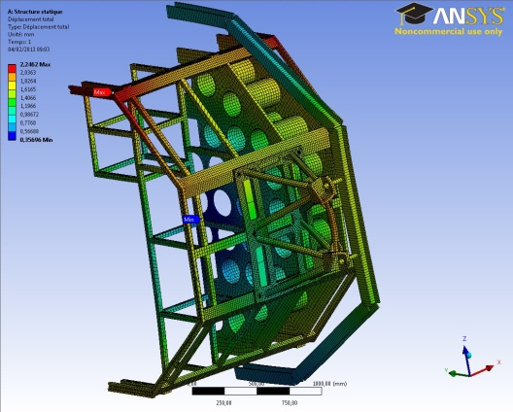
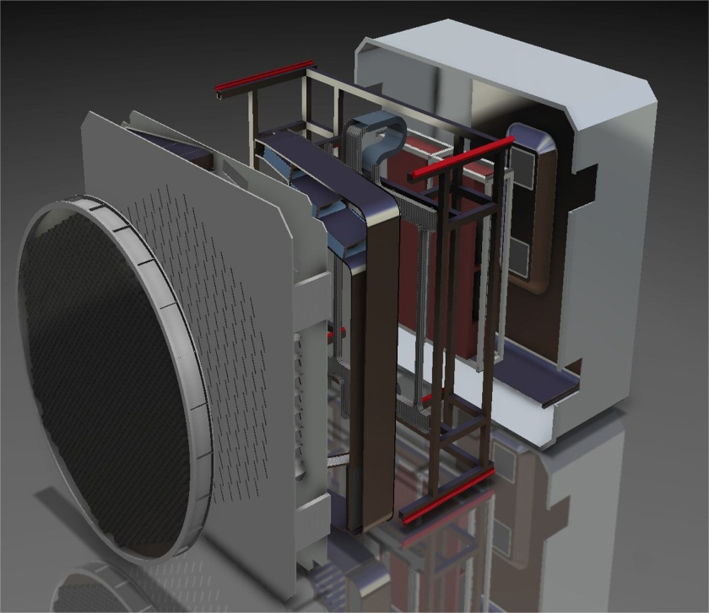

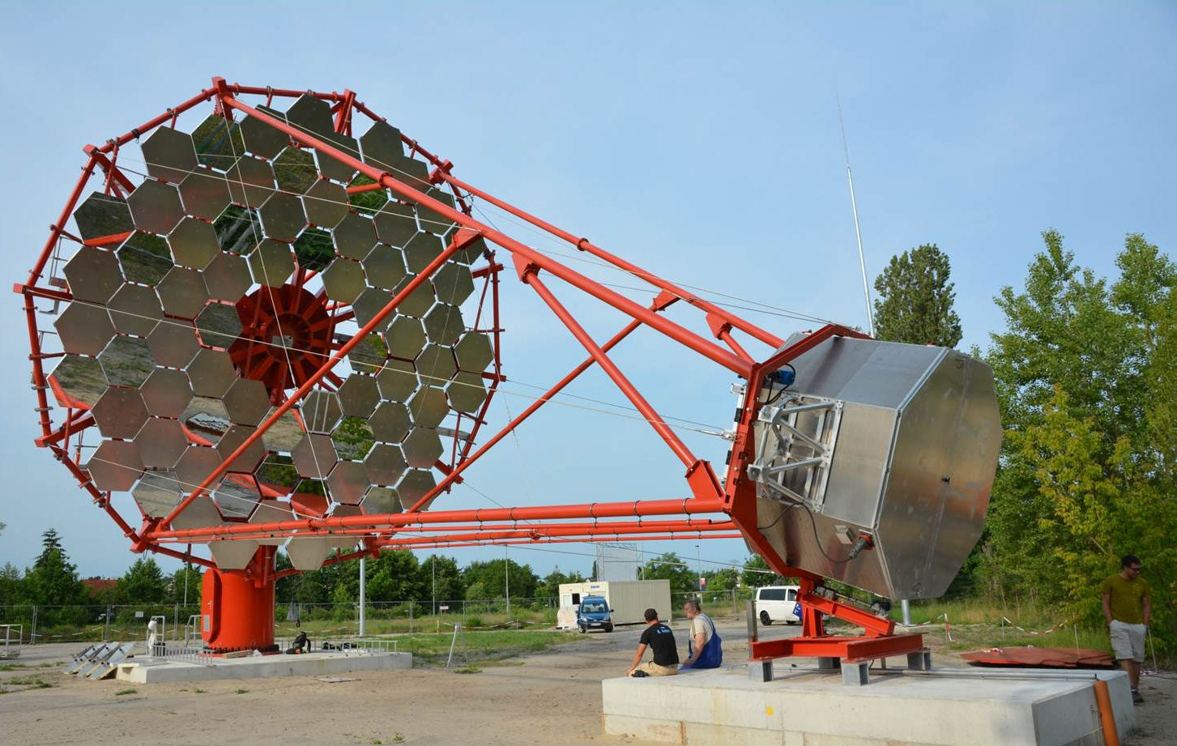
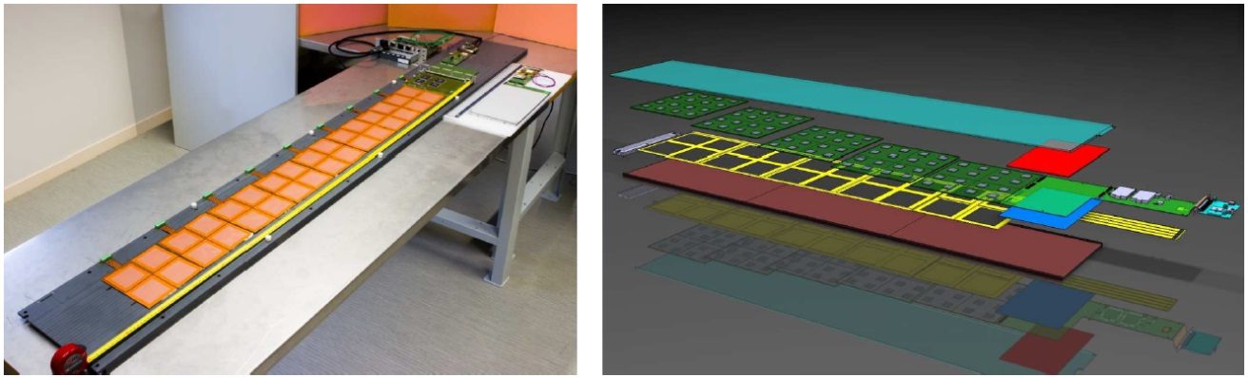
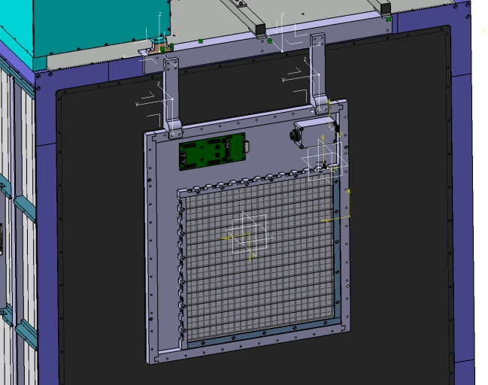
Mechanics
CTA NectarCam
Thermal study
GATE
DUMMY caméra
Cable Trays
Camera Enclosure
Camera Body
BE Equipment Cooling Unit
Back-end
Equipment
Entrance Window
FPI Cooling
Unit
ILD/ILC – ECAL
Long slab study
T2K
Aditional module

Slide 12
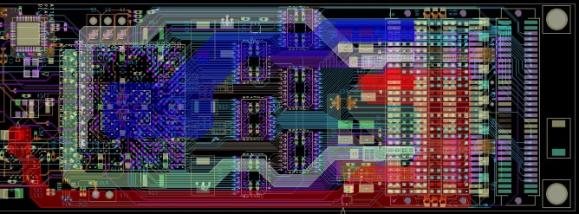
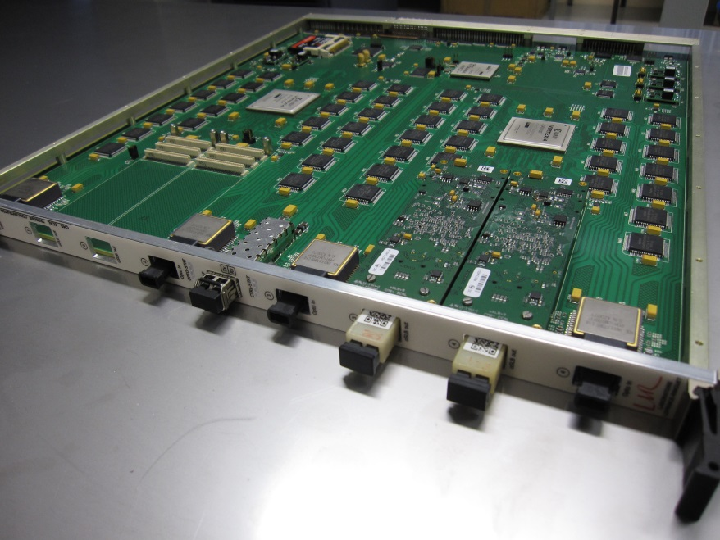
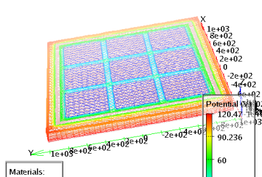
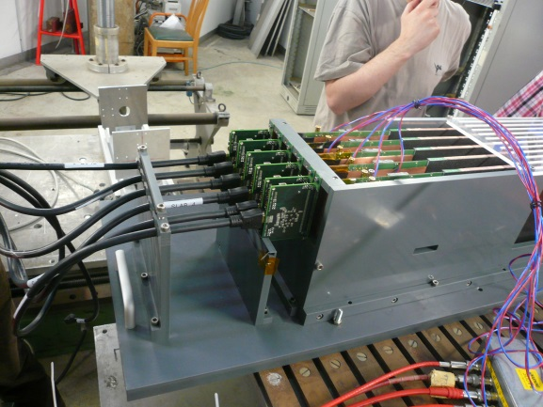
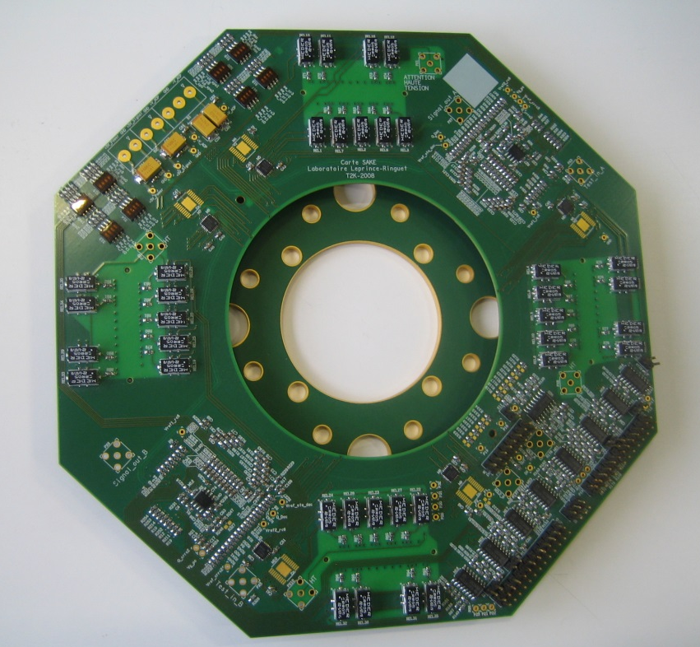
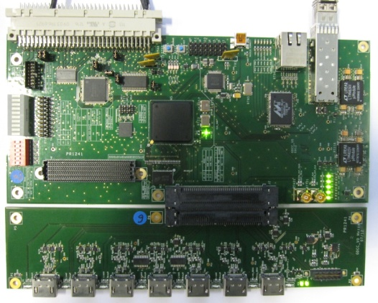
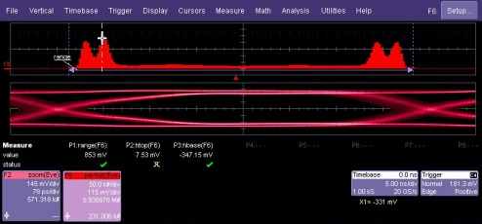
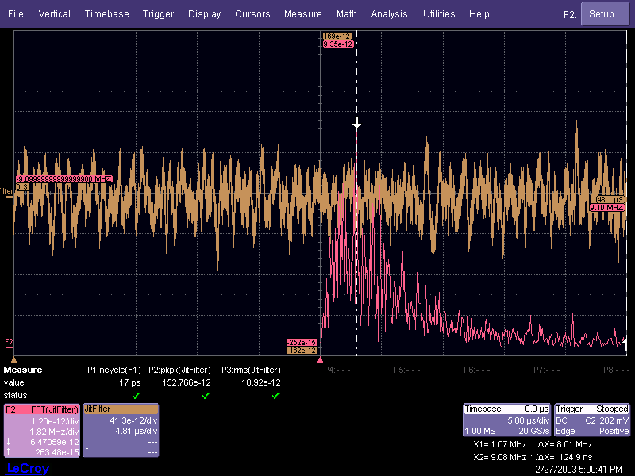
Electronics and instrumentation
    CAO / Complex Design
    High Speed Serial Link Test board
    Simulation of silicon
    detector
    ILC-Calice / Si-W ECAL prototype
    LHC-CMS experiment / Trigger card
    Measurement
    ILC-Calice / Data Concentrator
    MPCC Test Bench for T2K experiment
    Analyses

