Slide 1
Overview of LAL-Japan joint projects highlight → contributions to research at KEK
Philip Bambade
Laboratoire de l’Accélérateur Linéaire
Université Paris 11, Orsay, France
Meeting with MM. Oodoï and Ikeda 15 May 2014

Slide 2
Main LAL-Japan joint projects
– all projects within TYL-FJPPL –
LHC
Improvement of the τ jet measurement applied to the low mass H Higgs search in ττ channel
R&D for ATLAS GRID computing (with IRFU and CC-IN2P3)
ILC
ILC top quark investigations
B-meson physics
Flavour physics : joint efforts towards searching for physics beyond the SM (with LPT and LPNHE)
Accelerator R&D
Development of optical cavity systems for advanced photon sources (ATF)
Study & optimization of the power deposition density in new positron targets (with IPNL)
Nanometer stabilization studies at ATF2 (with LAPP)
Collaboration on fast luminosity measurements and MDI questions for SuperKEKB
Development & validation of input power couplers for superconducting linacs (with IRFU)
Astro-particle physics
Towards a new era in ultra-high-energy cosmic-ray studies (with APC and OMEGA)

Slide 3
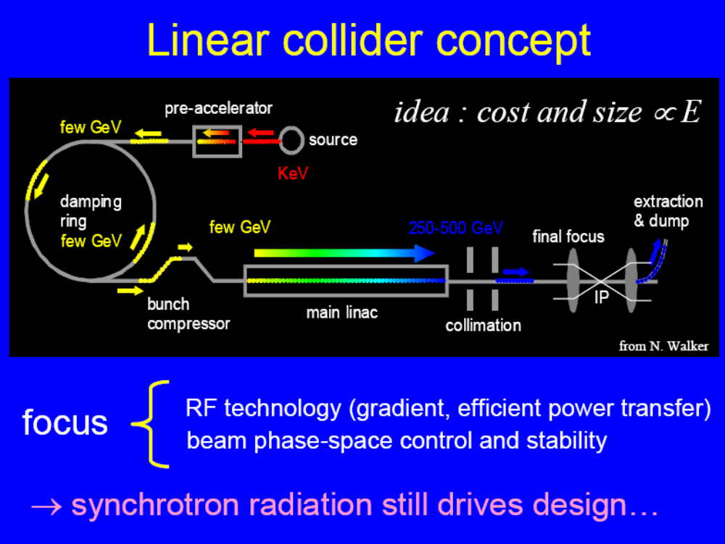
•
•

Slide 4
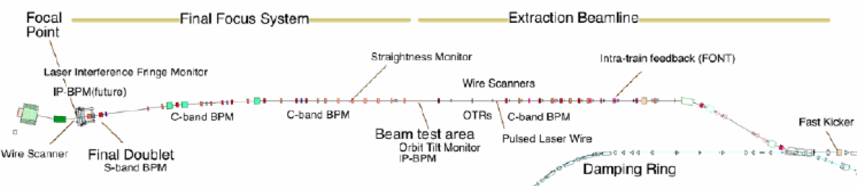
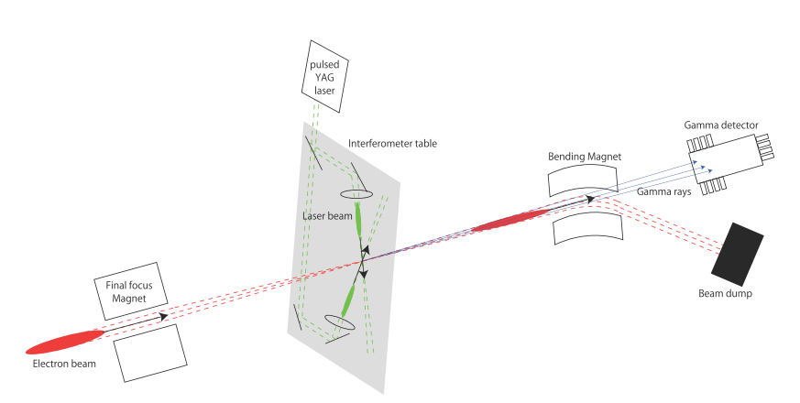
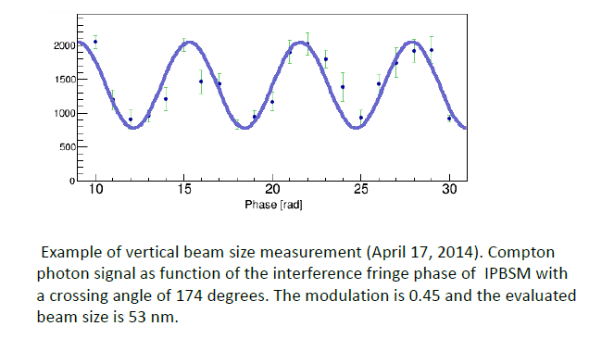
Accelerator Testing Facility (ATF) @ KEK
low energy (1.3GeV) prototype of the final focus system for ILC and CLIC
ATF2
Shintake Monitor
53nm beam size measured in Apr. 2014
Compton
Diamond Sensor
preliminary
Goals of ATF
goal 1—achieving the 37 nm design vertical beam size at the IP
goal 2—stabilizing the beam at the IP at the nanometer level

Slide 5
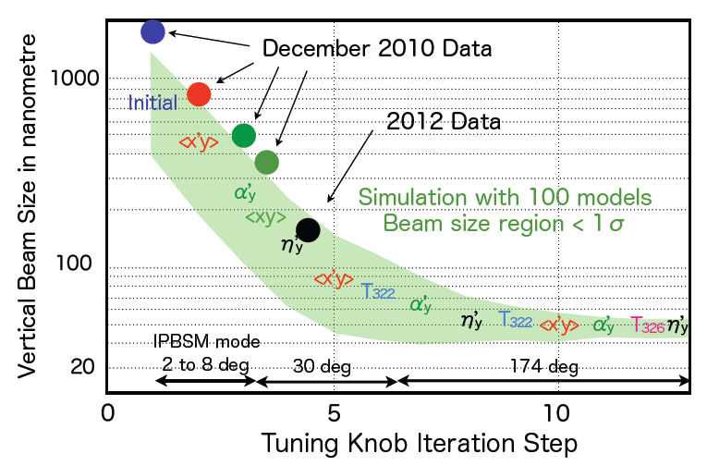
Tuning the ATF2 vertical beam size
March 2013
preliminary
2011 earthquake
April 2014

Slide 6
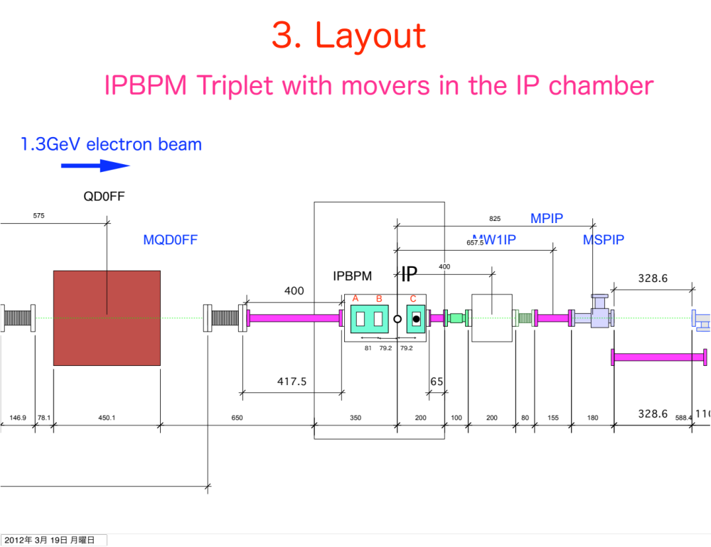
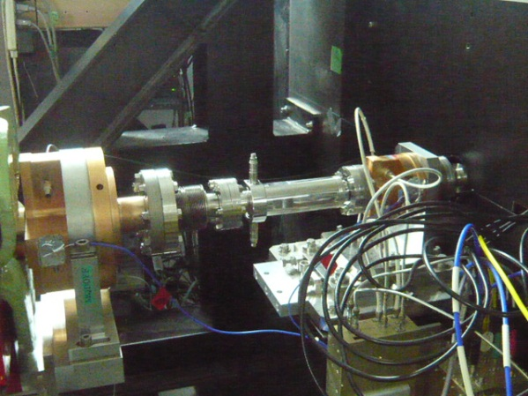
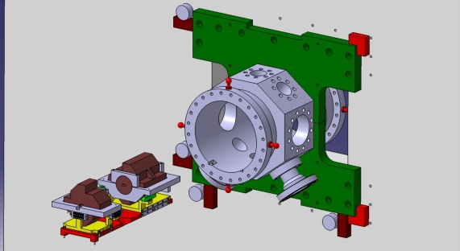
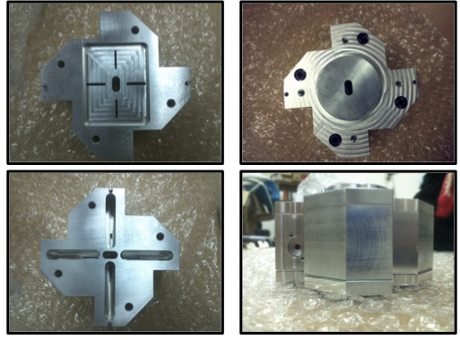
ATF2 goal 2 : nm-beam position stabilization
New FONT-kicker
Installed near the ATF2-IP
Used since autumn 2012
New vacuum chamber
Precise positioning of IPBPM
triplet
KEK
KNU
LAL
JAI/Oxford
IP
Beam
Triplet of New IPBPM
Low-Q short gap cavity light weight BPM
Sensitivity tested at ATF LINAC
Readout electronics tested at ATF2

Slide 7
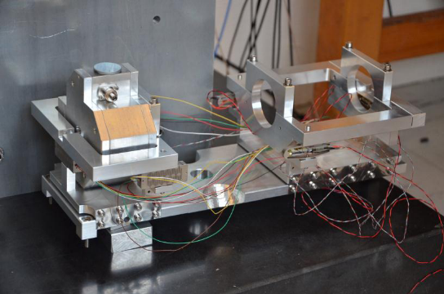
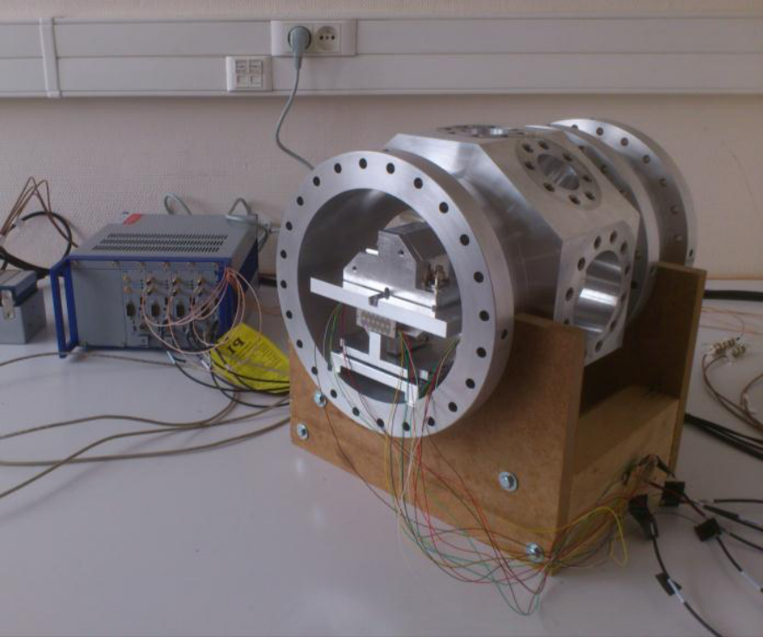
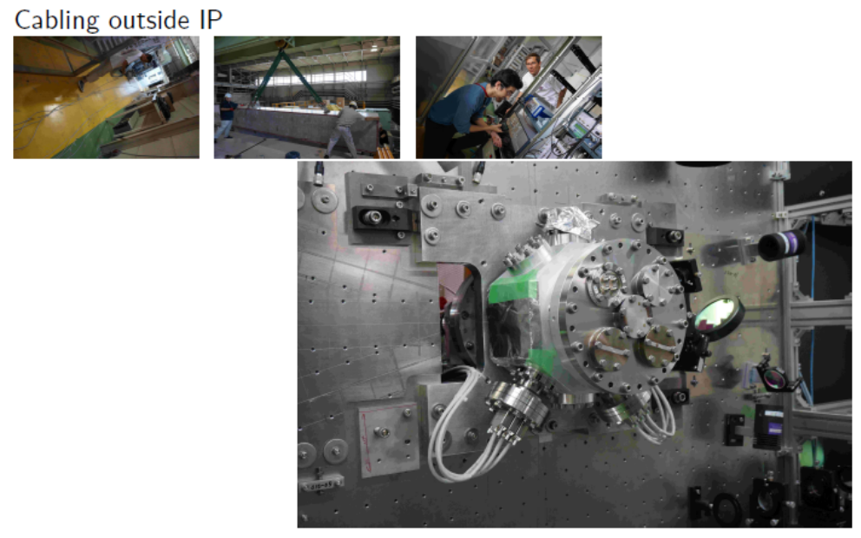
New IP vacuum chamber from LAL
Mechanical references for precise pre-positioning and alignment
Adjustable fixture for rigid mount on IP-BSM optical table
Base-plate + cradles support BPM1-2 and BPM3 in tripod configurations
Lateral & vertical adjustments with 8 piezo-movers in 230-300 μm range
Positioning within 10⁻⁴ of the range (strain gauges as input to feedback)
In-vacuum temperature monitoring
Remote electronics (25 meter cables)
Installed
&
operating !

Slide 8
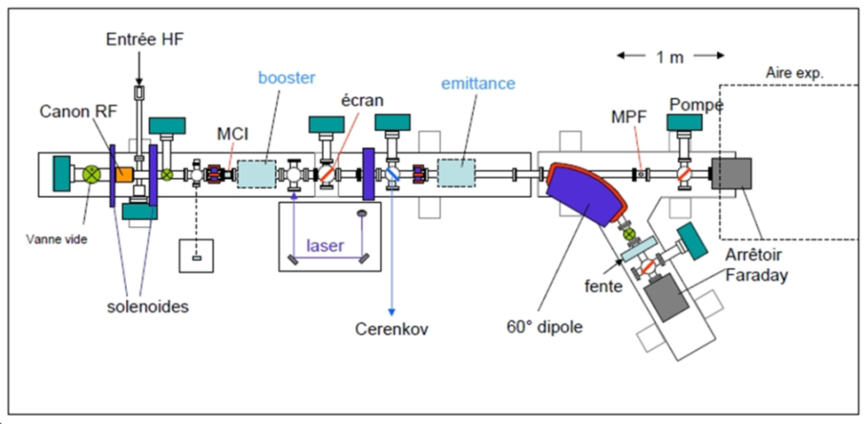
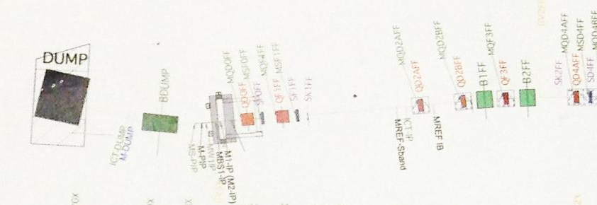
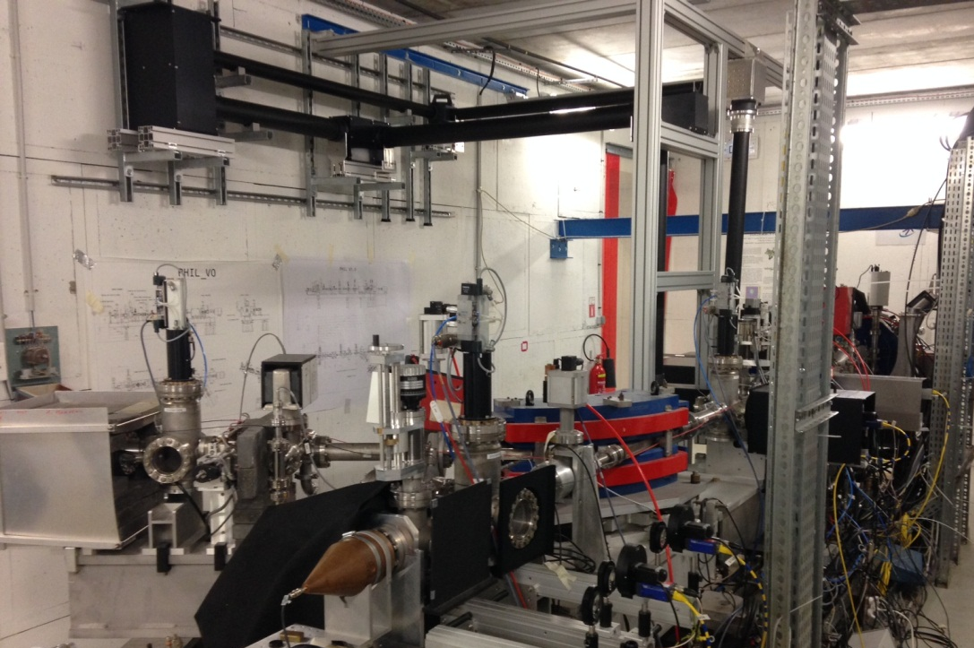
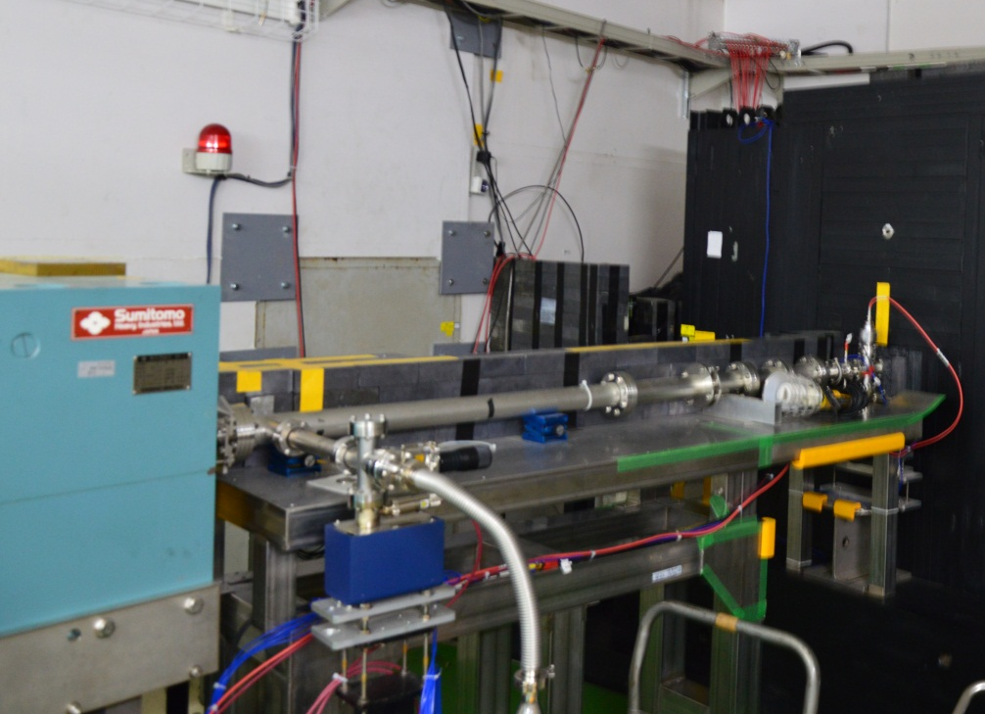
PHIL @ LAL
ATF2 @ KEK
Diamond Detector
Same "plug compatible" design for PHIL and ATF2: fabrication will be completed in April 2014 before testing in May-June at PHIL.

Slide 9
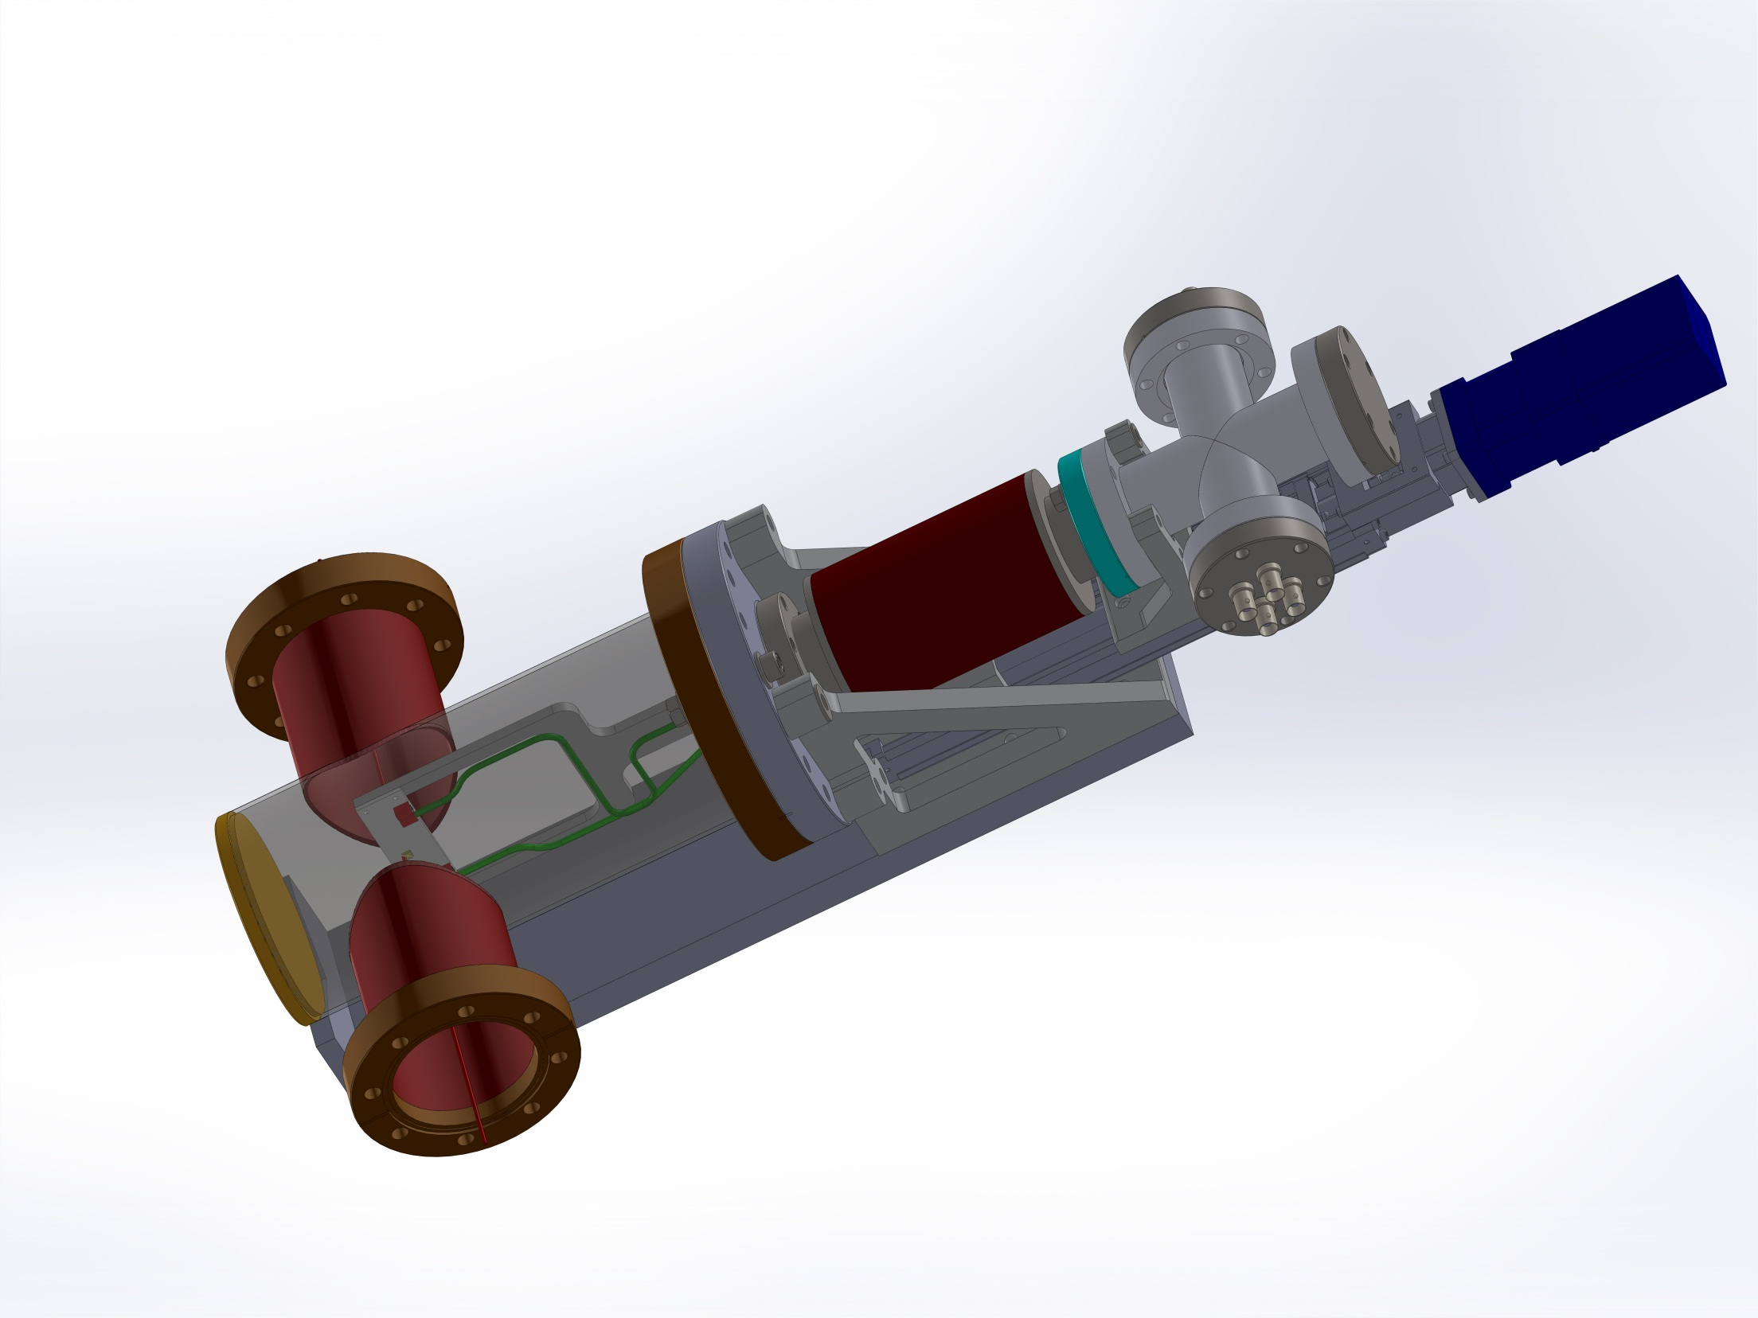
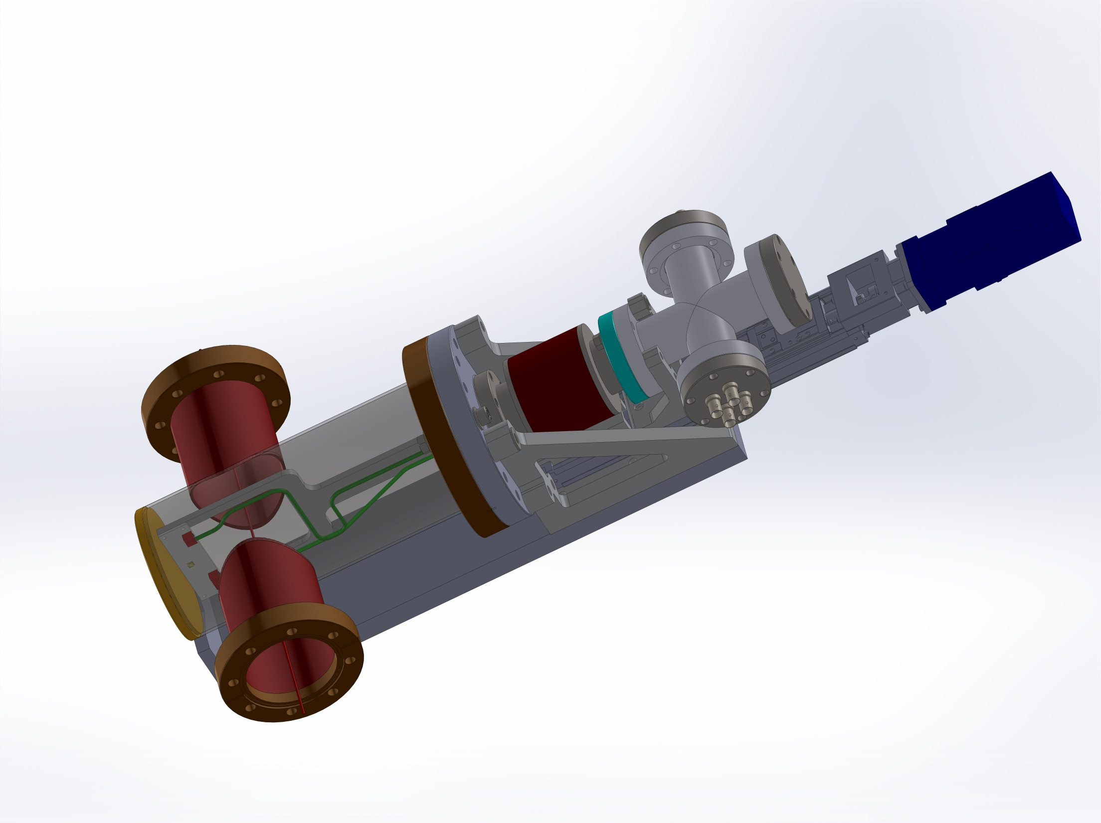
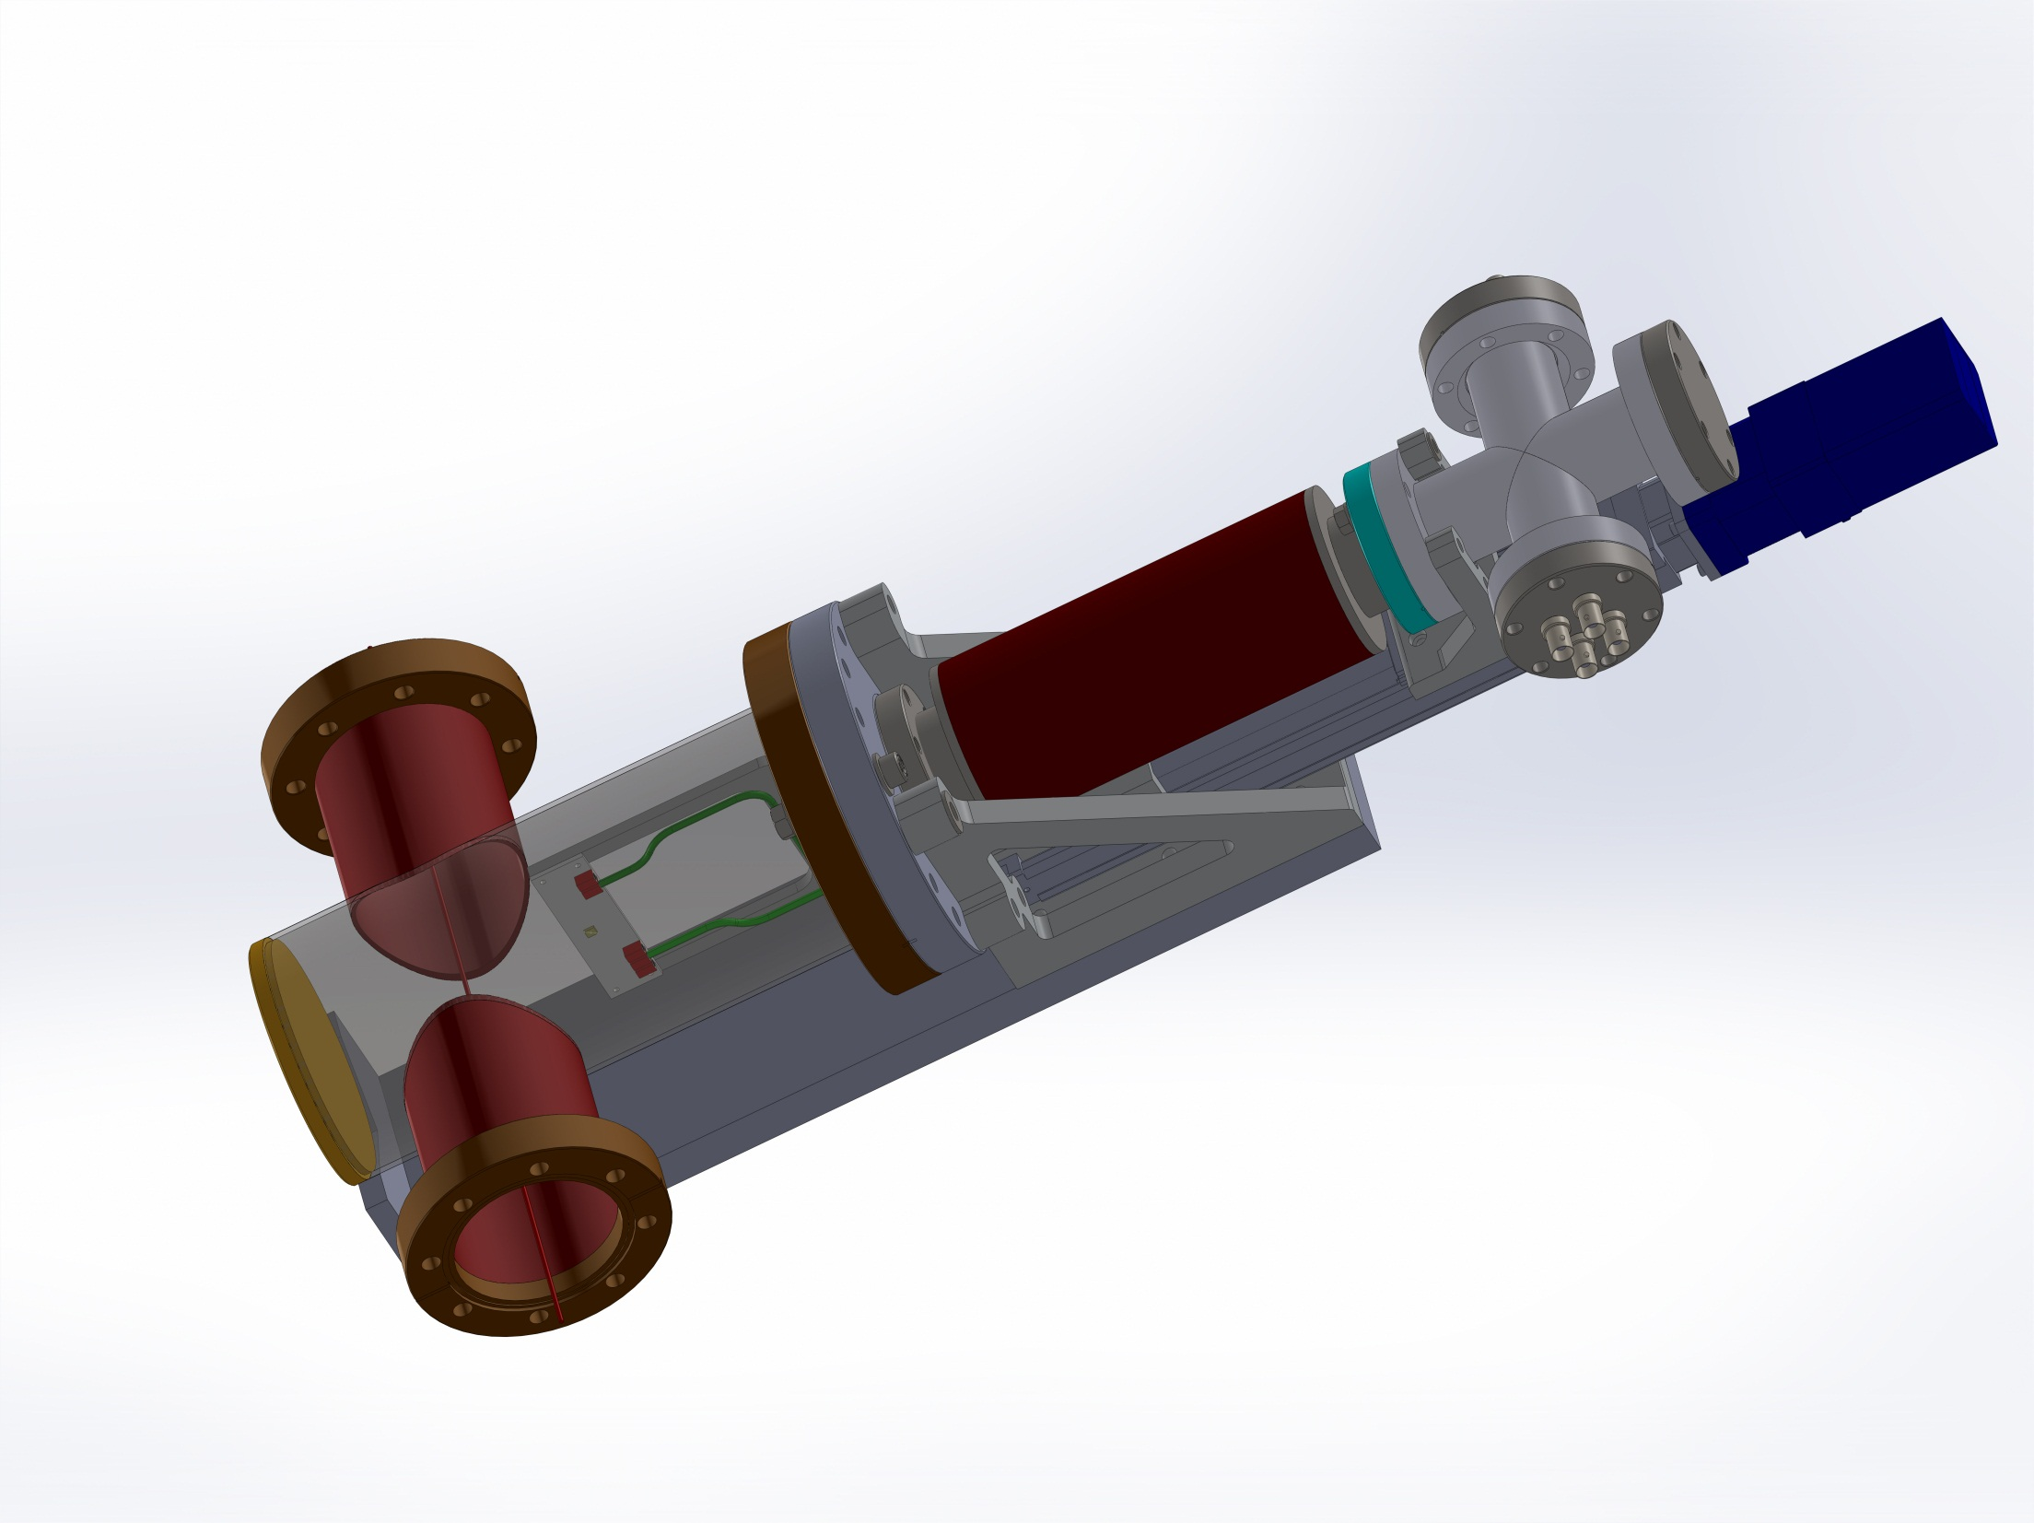
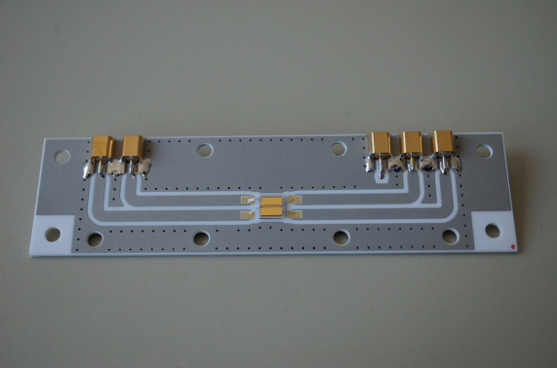
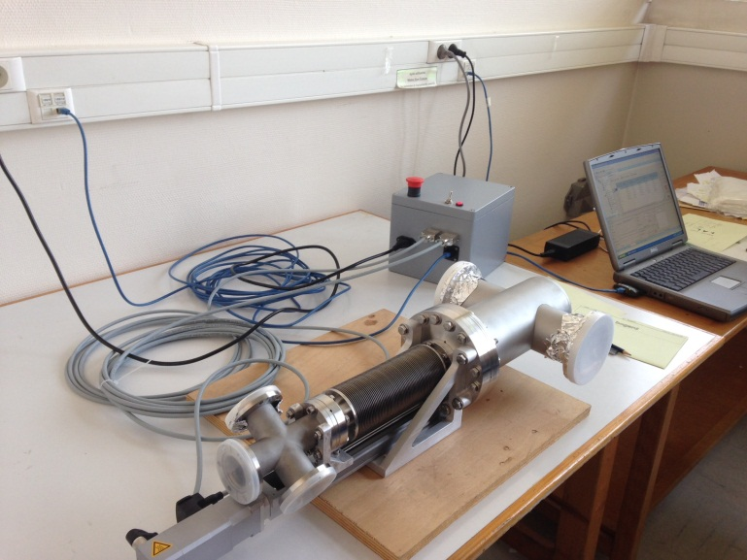
%
In-vacuum diamond halo sensor

Slide 10


ATFに参加している代表的研究機関
- ATF International Collaboration -
アメリカ(USA)
SLAC国立加速器研究所
ローレンス・バークレー国立研究所(LBNL)
フェルミ国立加速器研究所(FNAL)
ローレンス・リバモア国立研究所(LLNL)
ブルックヘブン国立研究所(BNL)
コーネル大学(Cornell Univ.)
ノートルダム大学(Notre Dome Univ.)
欧州原子核研究機構(CERN)
ドイツ(Germany)
電子シンクロトロン研究所(DESY)
フランス(France)
IN2P3; LAL, LAPP, LLR
イギリス(UK)
Univ. of Oxford
Royal Holloway Univ. of London
STFC, Daresbury
Univ. of Manchester
Univ. of Liverpool
Univ. College London
イタリア(Italy)
INFN, Frascati
スペイン(Spain)
IFIC-CSIC/UV
ロシア(Russia)
Tomsk Polytechnic Univ.
日本(Japan)
高エネルギー加速器研究機構(KEK)
東北大学 (Tohoku Univ.)
東京大学 (Univ. of Tokyo)
早稲田大学(Waseda Univ.)
名古屋大学(Nagoya Univ.)
京都大学 (Kyoto Univ.)
広島大学 (Hiroshima Univ.)
中国(China)
中国科学院高能物理研究所(IHEP)
韓国(Korea)
ポハン加速器研究所(PAL)
キョンプク大学(KNU)
インド(India)
Raja Ramanna Centre for Advanced Technology
先端加速器試験装置（ATF）

Slide 11
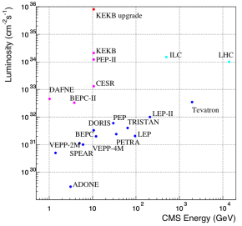
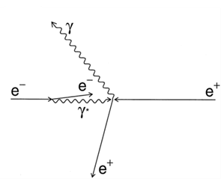
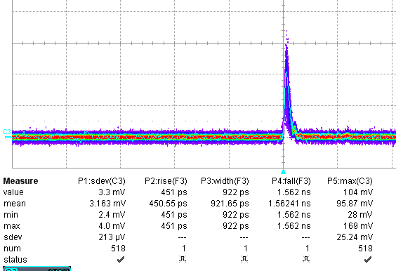

Fast Luminosity monitoring with diamond sensors @ Belle2/SuperKEKB
Philip Bambade, Dima El Khechen, Didier Jehanno, Cécile Rimbault
SuperKEKB: Very high luminosity e⁺e⁻ collider
(8 10³⁵ cm⁻²s⁻¹) (E₊=4 GeV, E₋=7 GeV)
    nano-beam scheme, very low beam sizes
    high currents ( coll @ 0.250 GHz)
Fast luminosity monitoring is required in presence of
dynamical imperfections
    for fine tuning during lumi optimisation phase
    survey during physics run
    Required precision: δL/L ~10⁻³/10ms
    Lumi monitoring for each bunch crossing: collision every 4 ns
Measurement: radiative Bhabha scattering at zero photon angle
    Large cross-section: ~0.2 barn
    Proportional to L
Technology: ~5x5 mm² diamond sensors
set immediately outside beam pipe
    Radiation hardness
    Fast charge collection
100 um PCDiamond
Courtesy of E. Griesmayer, CIVIDEC

Slide 12
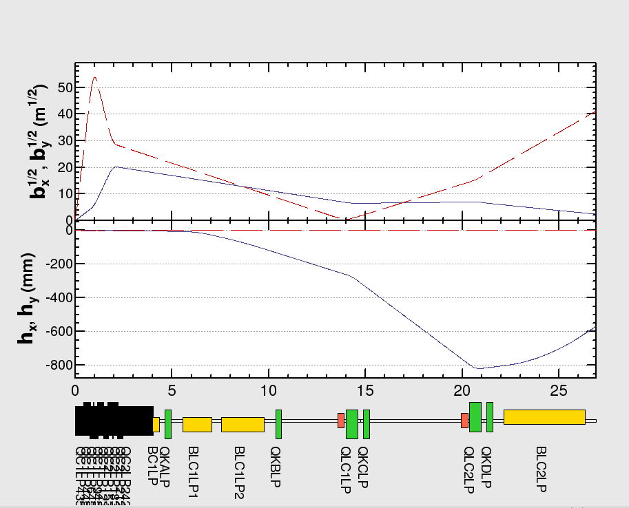
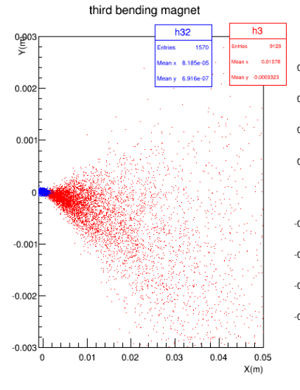
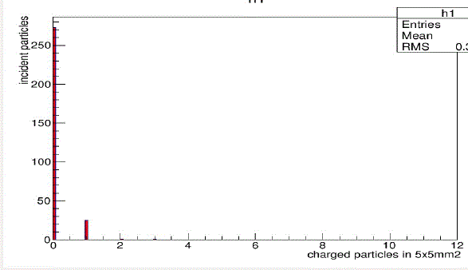
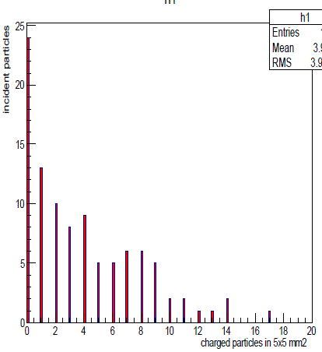
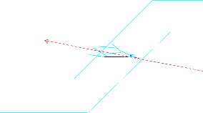

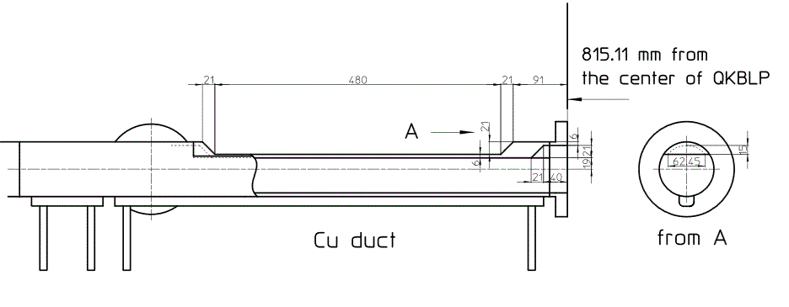
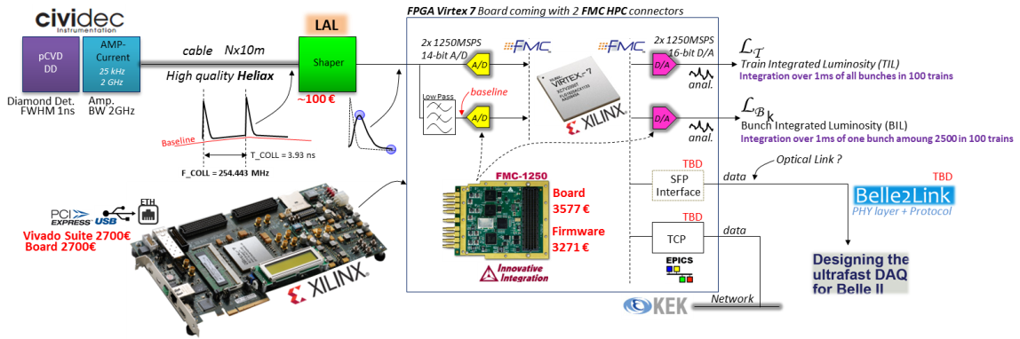
On-going design work
Search for optimal locations for the sensors
  Low energy e+/e- are deflected downstream of the IP after the bending magnets
  Study of the rate of Bhabhas which exit the beampipe
Beam pipe and sensor geometries
  interaction with the beam pipe material
  At 13.9 m dowstream the of IP, 3.35 GeV Bhabha positrons cross the beam pipe material (6mm of Cu) at 5 mrad
  signal rates in the sensors
  A modification of the vacuum chamber may be required (window)
Diamond sensors signal studies
  For SuperKEKB: signal width < 1-2 ns,
  since 4 ns bunch spacing
Electronic readout
No Window
Window
Window design proposed by Kanasawa-san

Slide 13
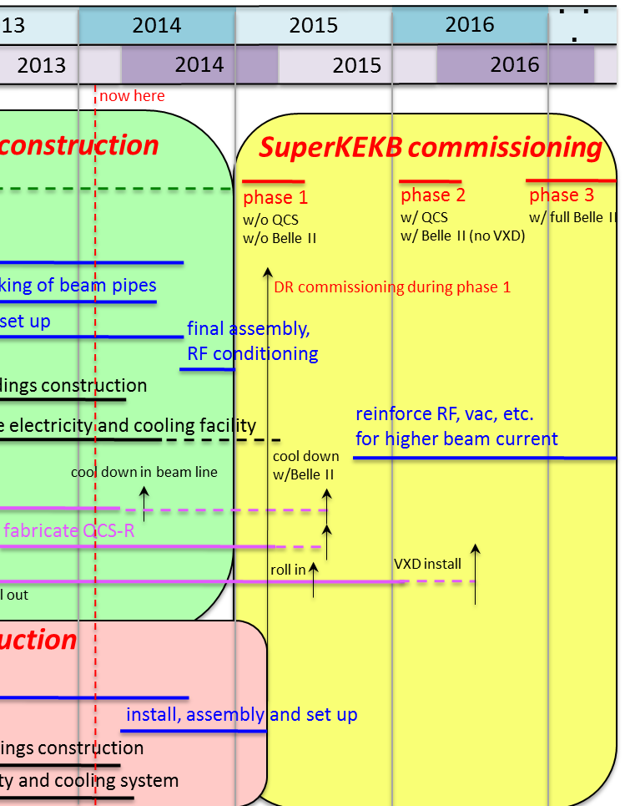
Schedule
Fall 2013-Spring 2014:
Study of Bhabha signals and background estimations
Study of secondaries interaction with beam pipe using GEANT4
Investigation of optimal sensor location and geometry
Spring 2014-Automn 2014 :
Prepare fast < 4ns sensor and 250 MHz readout
Laboratory tests (clean room and Phil @LAL...)
Prepare initial setup and data acquisition for beam synchronisation and background tests at SuperKEKB
2015:
Installation and tests at SuperKEKB
Synchronisation test and initial background measurements.
Finalise design of data acquisition for luminosity monitoring
2016:
First data for luminosity monitoring
Analysis (Dima’s PhD)
Optimisation in context of luminosity feedback

Slide 14
Extra slides

Slide 15
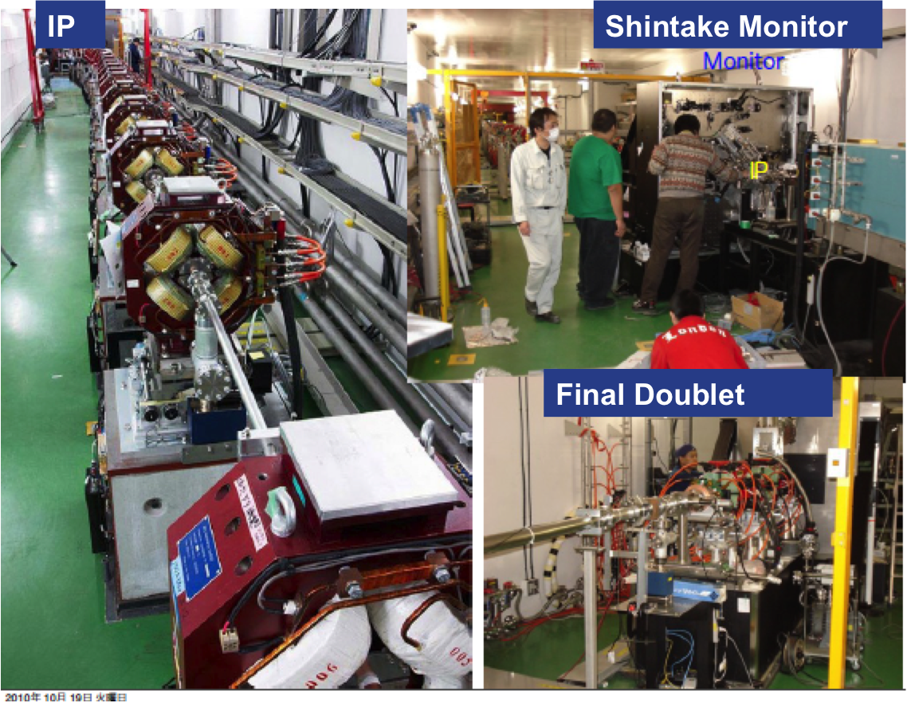

Slide 16


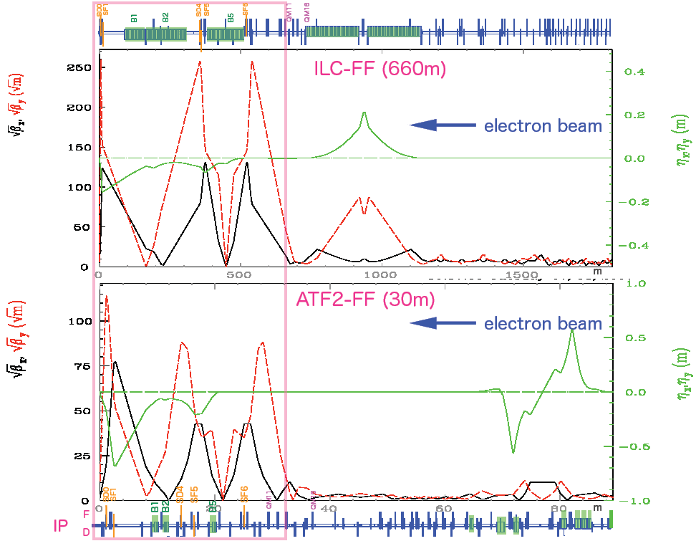
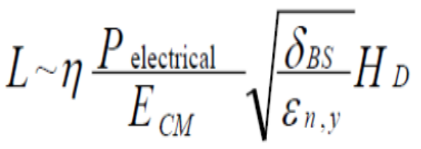
Parameters
ATF2
ILC
CLIC
SuperKEKB
Beam Energy [GeV]
1.3
250
1500
4-7
L* [m]
1
3.5 - 4.5
3.5
0.47-1.3
γε_{x/y} [m.rad]
5 10⁻⁶ / 3 10⁻⁸
10⁻⁵ / 4 10⁻⁸
6.6 10⁻⁷ / 2 10⁻⁸
~ 3 10⁻⁵ / ~ 1 10⁻⁷
IP β_{x/y} [mm]
4 / 0.1
21 / 0.4
6.9 / 0.07
25-32 / 0.27-0.41
IP η’ [rad]
0.14
0.0094
0.00144
β_{y} < σ_{z}
δ_{E} [%]
~ 0.1
~ 0.1
~ 0.3
0.065
Chromaticity ~ β / L*
~ 10⁴
~ 10⁴
~ 5 10⁴
1.7-3.2 10³
Number of bunches
1-3
~ 3000
312
2500
Bunch population
1-2 10¹⁰
2 10¹⁰
3.7 10⁹
IP σ_{y} [nm]
37
5.7
0.7
59
ATF2 =
scaled ILC FFS
start point of CLIC FFS
(SuperKEKB + FCC-ee/CEPC)

Slide 17
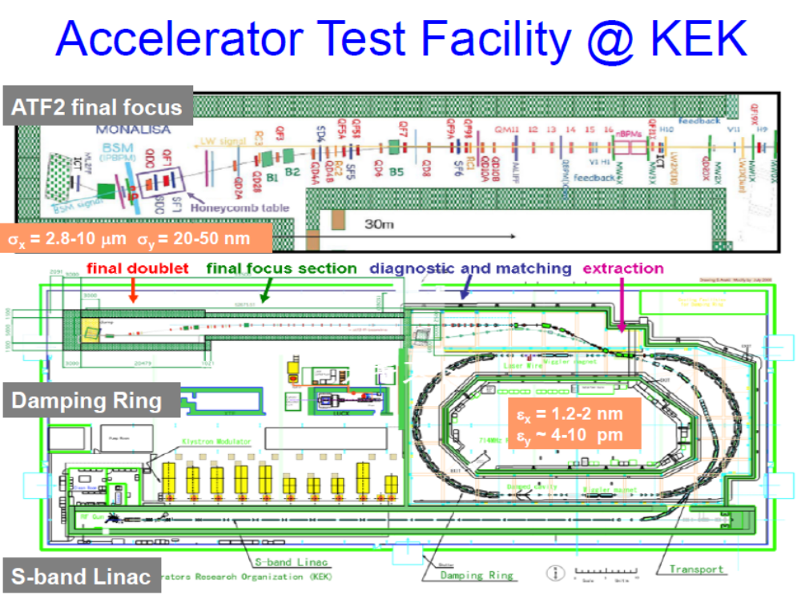
ATF & ATF2 R&D for linear colliders

Slide 18
ATF / ATF2 Goals
Very small damping ring vertical emittance
- from ∼ 10 pm → 4 pm (achieved !) → 1-2 pm
Small vertical beam size “goal 1”
- achieve σ_{y} ∼ 37 nm (cf. 5 / 1 nm in ILC / CLIC)
- validate “compact local chromaticity correction”
❑ Stabilization of beam center “goal 2”
- down to ∼ 2nm
- bunch-to-bunch feedback ( ∼ 300 ns, for ILC)
R&D on nanometer resolution instrumentation
Train young accelerator scientists on “real system”
- maintain expertise by practicing operation
→ open & unique facility

