Slide 1
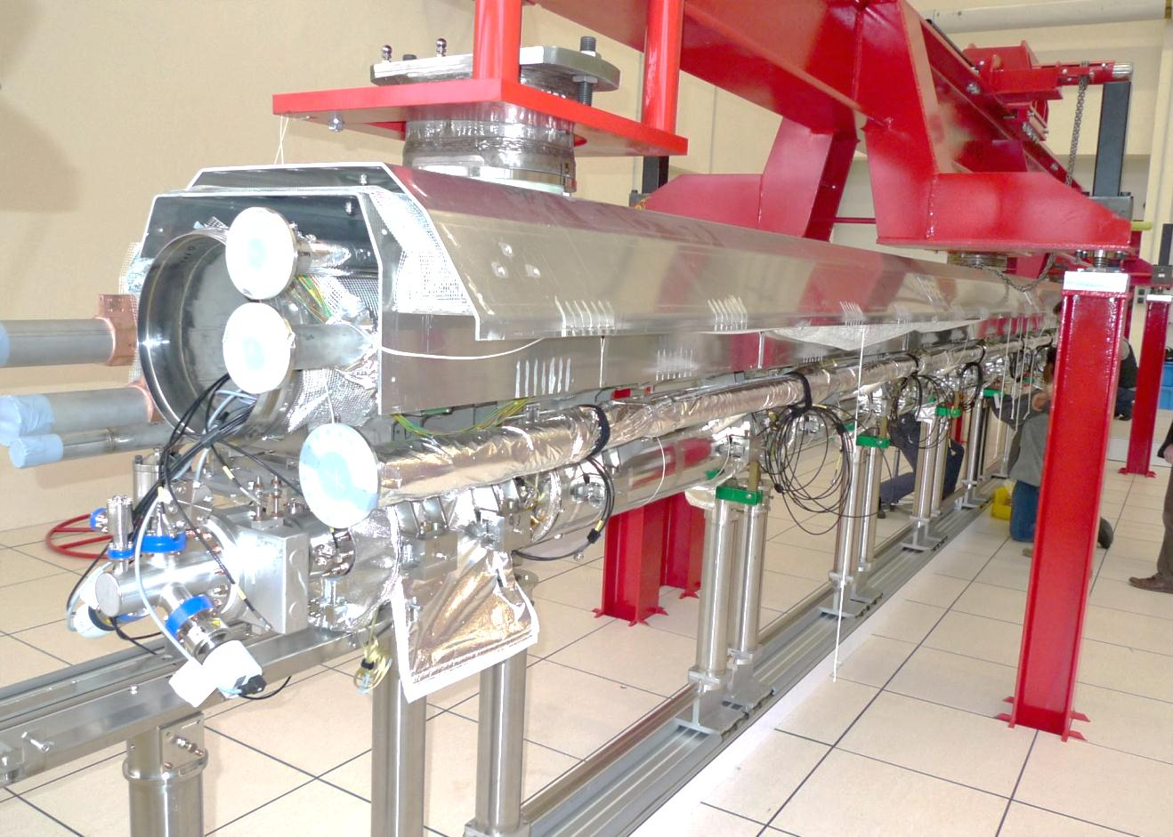
XFEL Module Assembly
O. Napoly, C. Madec
CEA-Saclay, Irfu/SACM

Slide 2
XFEL vs. ILC
The 4 reasons why the XFEL cryomodule production is useful for the ILC :
Industrialization
ILC cryomodule demonstration
XFEL linac system test
Infrastructures for ‘EU Hub’ for ILC cryomodule production
in chronological order.

Slide 3
XFEL vs. ILC: XFEL Linac System Test

Slide 4
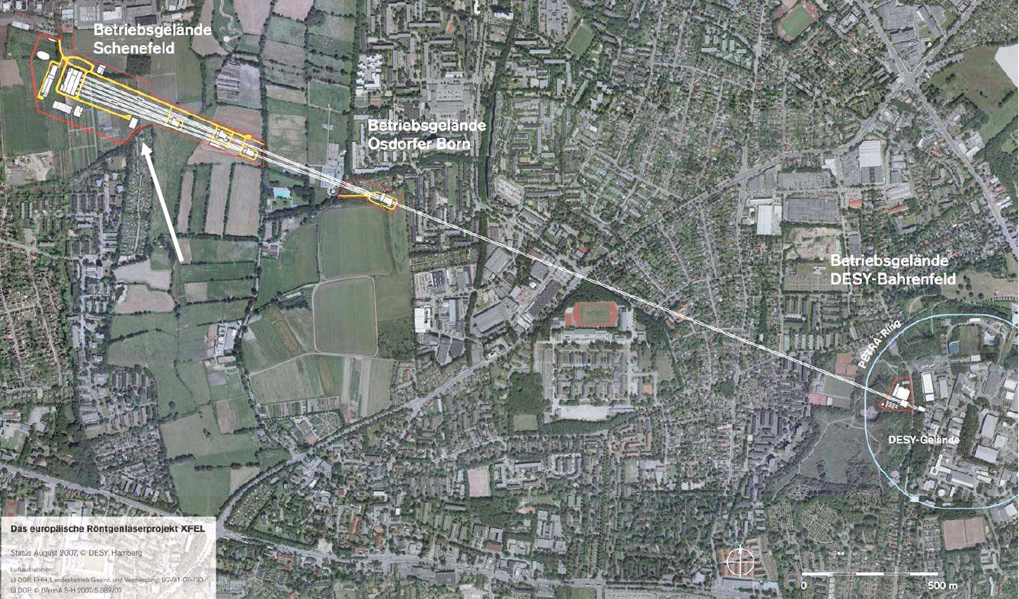
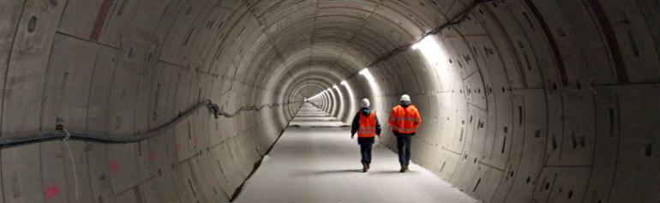
XFEL accelerator is a factor 10 smaller than ILC @ 250GeV c.m. energy
Linac supraconducteur de 17,5 GeV e⁻

Slide 5
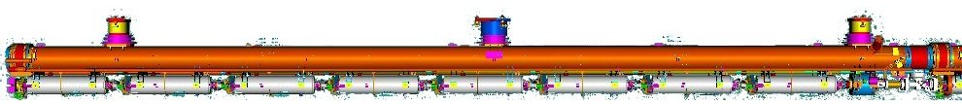
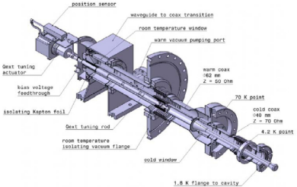





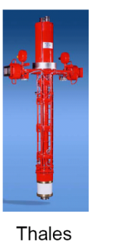
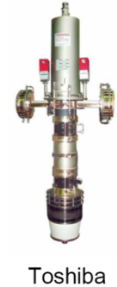
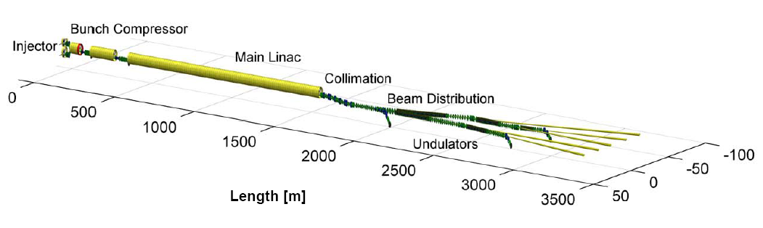
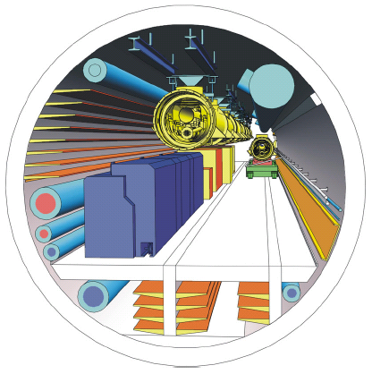
LINAC technology will be 90% identical
101 cryomodules
808 cavités
1.3 GHz / 23,6 MV/m
808 coupleurs RF
120 kW @ 5 mA
26 stations RF (10 MW) opérant à 5,2 MW
1
1
7
18-38 m s/sol
1 secteur cryogénique (12 modules) : 120 W @2K, 204 W @5-8K, 1,4 kW @40-80K

Slide 6
XFEL Linac System Test
XFEL Linear Accelerator is only a factor 10 shorter that the ILC @ 250 GeV c.m. energy.
The RF technology will be 90% similar.
The beam operation will be very similar:
~1 ms pulse
~ 1 mA pulse current
~ 0.5 % duty cycle
When XFEL linac operates (2016) it will provide a large scale system-test of the ILC: alternate technical choices will be very difficult to justify if ILC performance is achieved.

Slide 7
XFEL vs. ILC: Industrialisation
The 5 reasons why the XFEL Industrialisation is beneficial to the ILC:
Building of expertise and infrastructure in EU labs
Building of expertise and infrastructure in Industry
Networking EU industries
Breaking ground for key technical aspects, e.g.
  brazing of coupler,
  pressure equipment certification for cavities and Helium tanks, etc…
  large scale quality management (industrial methods, EDMS)
Reliable costing, including schedule and manpower

Slide 8
Cryomodule Assembly at CEA-Saclay
Commitment of CEA to the E-XFEL Accelerator Consortium:
assembly of 103 accelerator modules
with 1 per week throughput !
operated by an industrial contractor
on the Saclay site and with CEA infrastructures

Slide 9
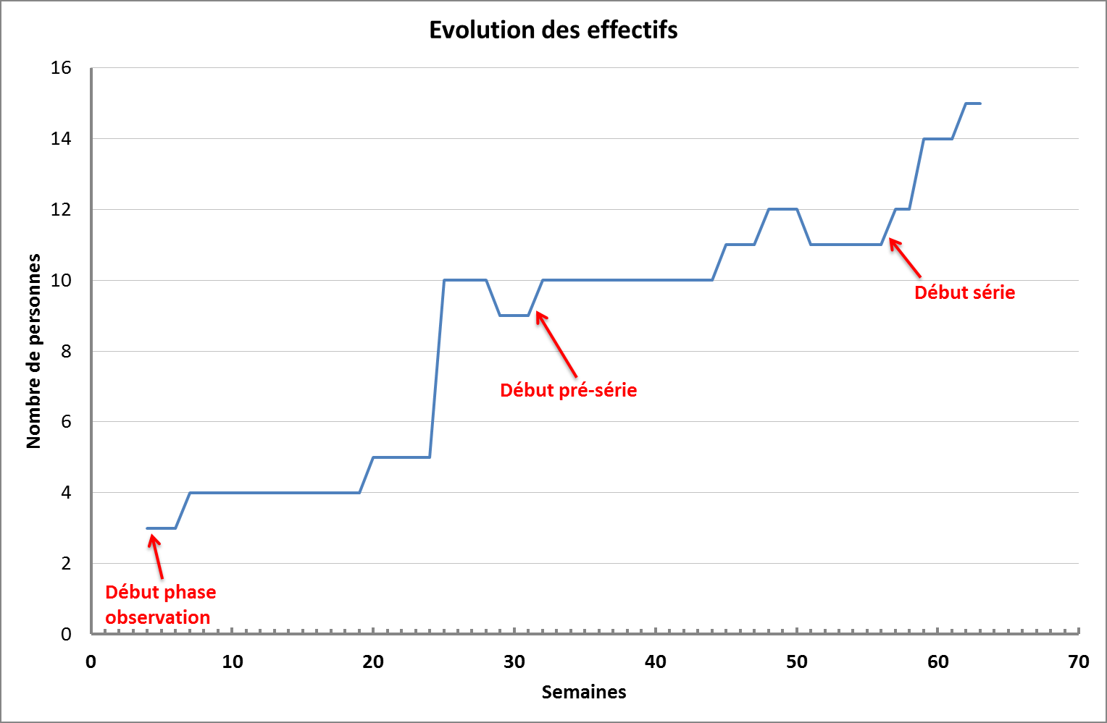
Industrial Contract Phases and
ALSYOM Staffing
Staff Evolution
Start of production phase
XM2
Start of training phase
23/09
XM1
04/09
XM-1
XM-2
01/07
XM-3
02/04
07/08
17/09
24/04
Start of observation phase
w38
w1
w11
w21
w31
w41
w51
2012
Project Weeks
2013

Slide 10
XFEL vs. ILC:
ILC Module Demonstration

Slide 11
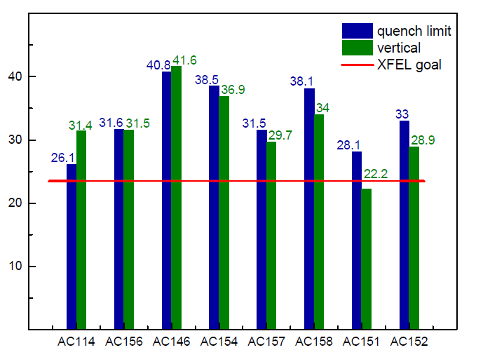
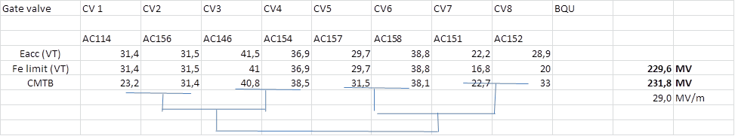
XM-3 RF Test Results
cryomodule test
cavity tests

Slide 12
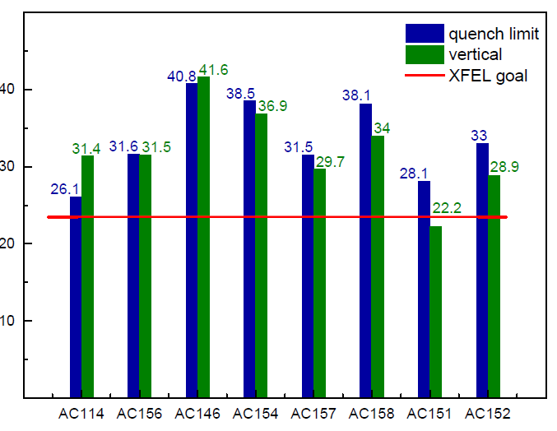
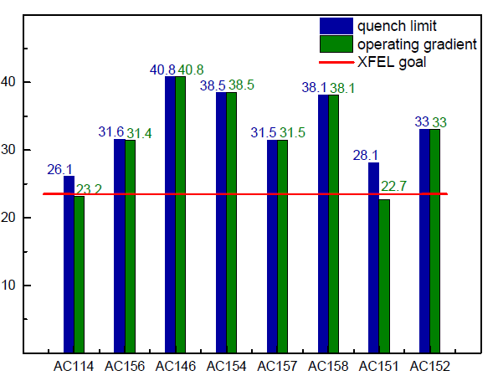
XM-3 : ILC Cryomodule
A success for SRF Technology
Average individual cavity gradient: 32 MV/m
Average cavity pair gradient: 29 MV/m
Three cavities reach gradients above 38 MV/m
Cryogenics losses are lower than specified.
A success for String and Module Assembly:
Seven cavities are reproducing VT gradient
The cryomodule reproduces gap of 230 MV
Cavity 1 is degraded from 31 down to 23 MV/m useable gradient: gate valve/cav1 connection not for training !
Qualifies CEA assembly team (100% string assembly by CEA), procedures and partially the production tool (ISO4 clean room, DESY pumping units, 3 mobile clean rooms, procedures, big tools)
The clean room vacuum system was not complete (CEA cavity venting on rails)
A success for the industrialization process:
XM-3 is the assembly demonstration cryomodule of CEA w.r.t. ALSYOM contract.

Slide 13
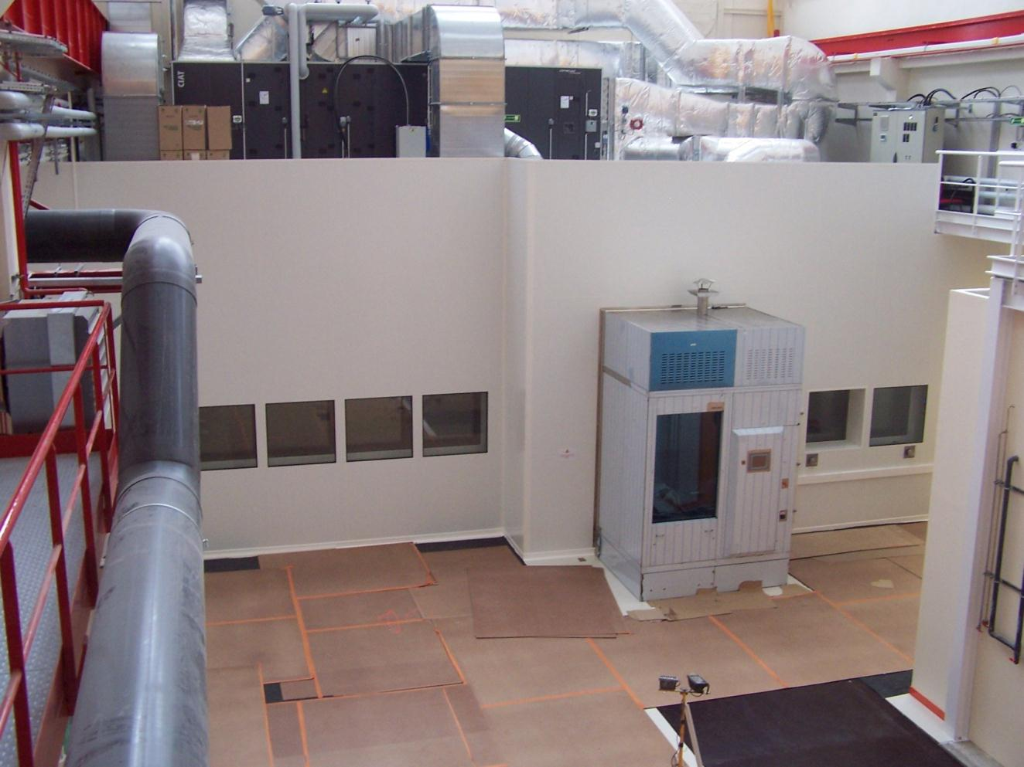
Infrastructures for ‘EU Hub’ for ILC cryomodule production
XFEL Village at Saclay

Slide 14
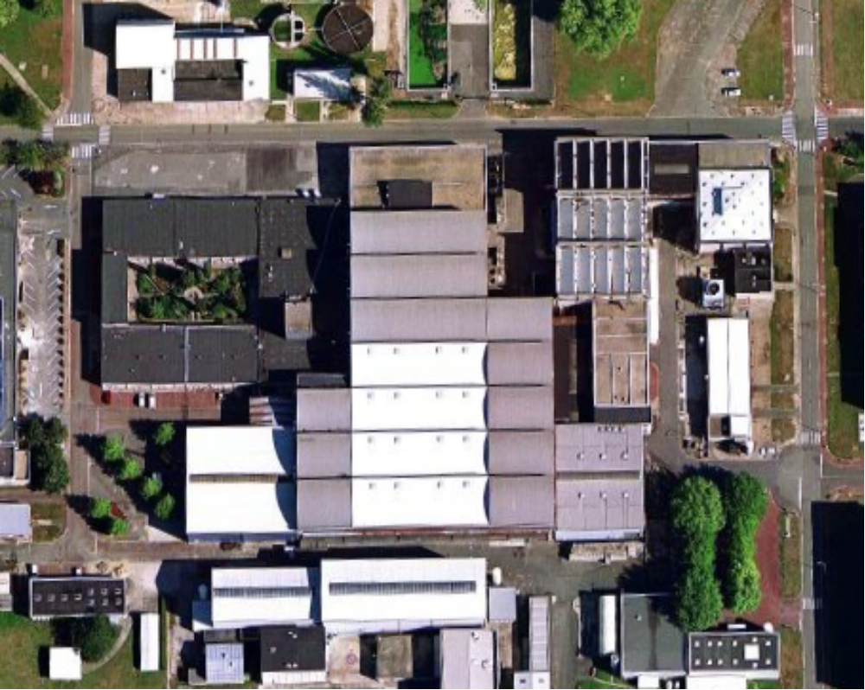
Overview of the Assembly Buildings
XFEL Village
Clean rooms
7
6
4
Bât 124 Nord
25x15 m²
CourtYard
3
2
Assembly halls
Bât. 126 Nord 40x11 m²
5
1
8
Bât. 126 Sud 30x17 m²
Offices
6b
Warehouse
©GoogleMap

Slide 15
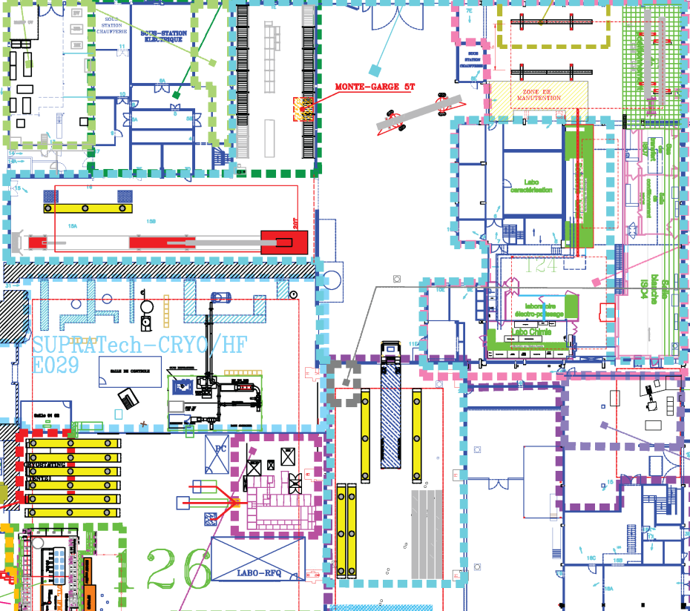
Village XFEL: 7 stations de travail
Roulage
RO-WS1 & 2
Aire Alignement AL-WS1 & 2
Magasin
Aire Coupleurs CO-WS1 & 2
Aire Réception
REC-WS1
Salle Blanche
CO-WS1 & 2
SA-WS1 & 2
Aire Enfourneur CA-WS1
Les sept stations, optimisées pour cinq jours de travail, forment une chaîne de montage de sept semaines, pour une cadence hebdomadaire d’expédition.
Aire Expédition
SH-WS1 & 2

Slide 16
Organisation of Work Stations
Clean Room Cold Coupler Area (IS04-CC-WS1)
  Cold coupler assembly
Clean Room String Assembly Area (ISO4-SA-WS1, ISO4-SA-WS2)
  String connections (1 gate valve + 8 cavities + 1 Qpole unit)
Roll-out Area (RO-WS1, RO-WS2)
  HOM tuning, magnetic shielding, tuners,…
  2Ph-tube welding, cold-mass connection
Alignment Area (AL-WS1, AL-WS2)
  Cavity and quadrupole fine alignment
  Coupler shields and braids, tuner electric tests
Cantilever Area (CA-WS1)
  Welding of 4K and 70 K shields, super insulation
  Quad current lead
  Insertion into vacuum vessel and string alignment
Coupler Area (CO-WS1, CO-WS2)
  Warm couplers + coupler pumping line
  Control operations (electrical, RF)
Shipment Area (SH-WS1, SH-WS2)
  CEA-Alsyom “acceptance test”
  End-caps closing, N2-insulation, loading.
In full production, this chain of workstations will be fully occupied with 7 cryomodules (XM_{n-6} @ WS1,…, XM_{n} @ WS7) stationed for one week.
A Cryomodule Factory !

Slide 17
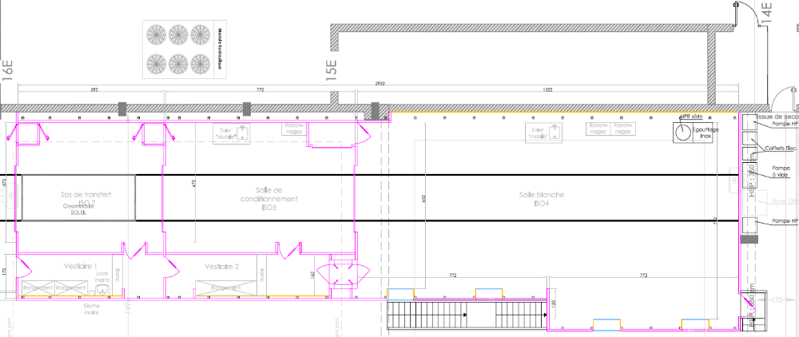
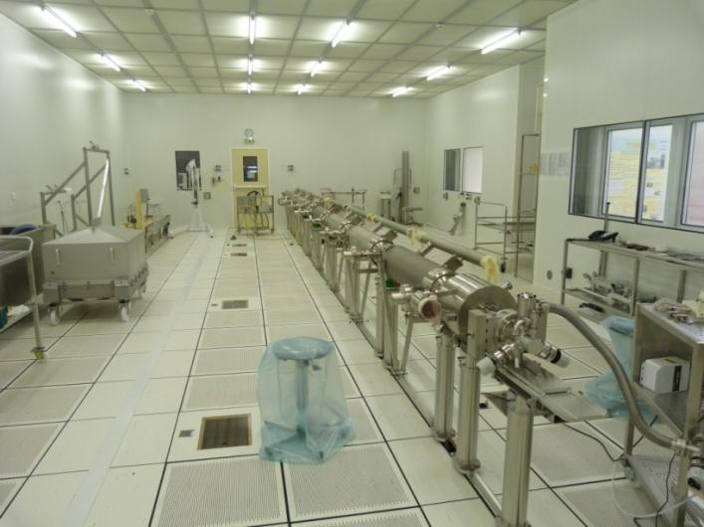
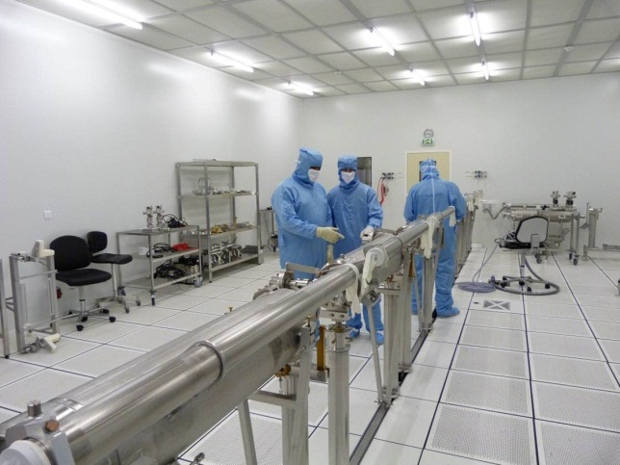
Clean Room Layout
ISO 7
(class 10 000)
28 m²
5.92 m x 4.72 m
ISO 5
(class 100)
38 m²
7.72 m x 4.72 m
ISO4 (Class 10)
112 m²
7.8 m x (6.6+7.8) m
15.6 m
May 2012
PXFEL2_2
December 2012
XM-3, with Alsyom

Slide 18
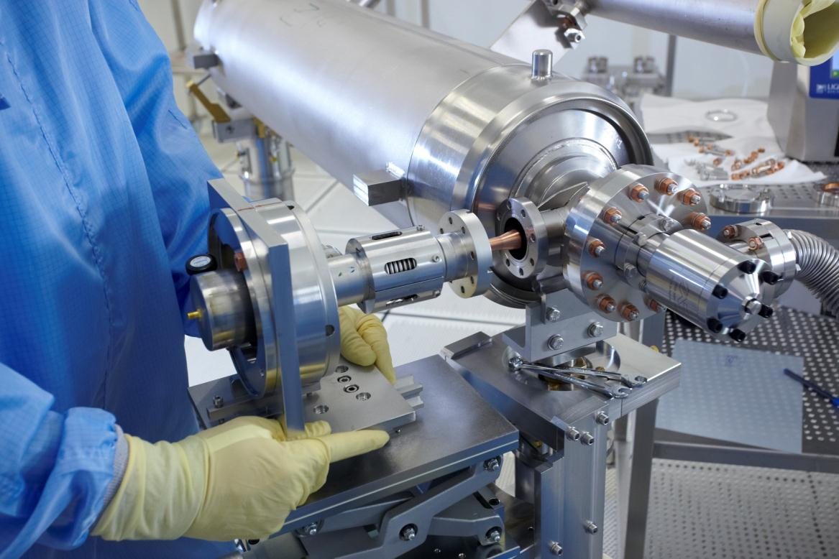
Assembly prototyping at Saclay
1. Coupler Cold Part assembly (ISO4-CC-WS1&2)

Slide 19
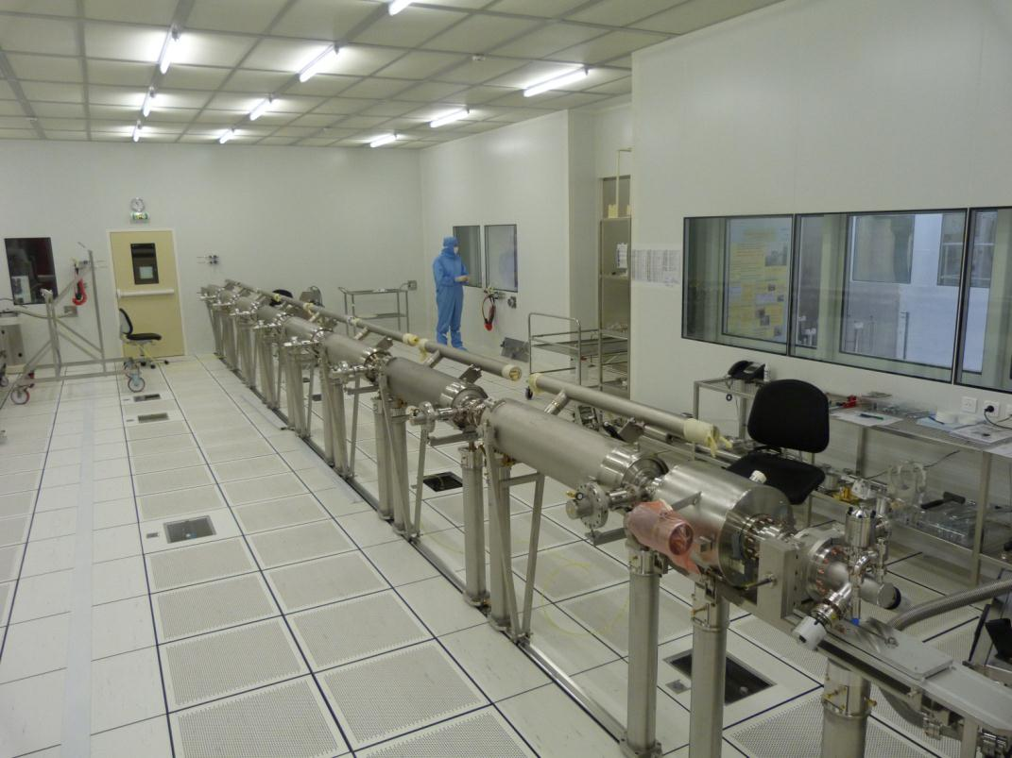
Assembly prototyping at Saclay
2. Cavity String assembly (ISO4-SA-WS1&2)

Slide 20
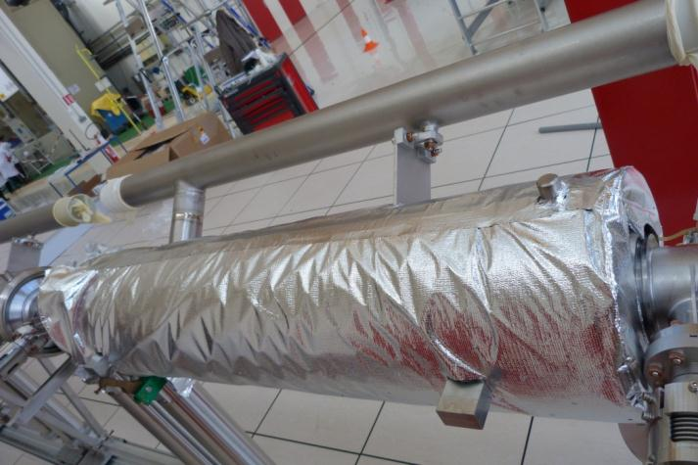
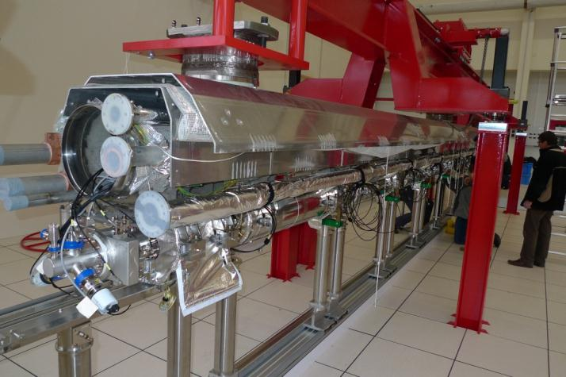
Assembly prototyping at Saclay
3. String dressing on Roll-out station (RO-WS1&2)

Slide 21
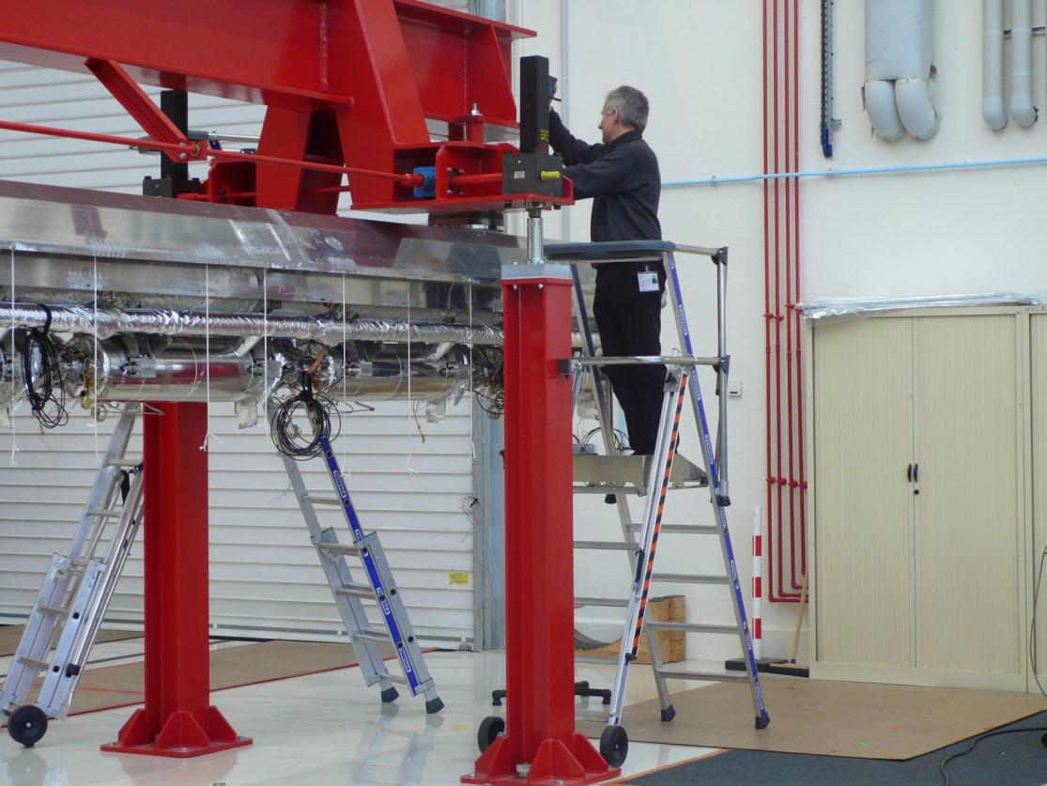
Assembly prototyping at Saclay
4. Alignment (AL-WS1&2)

Slide 22
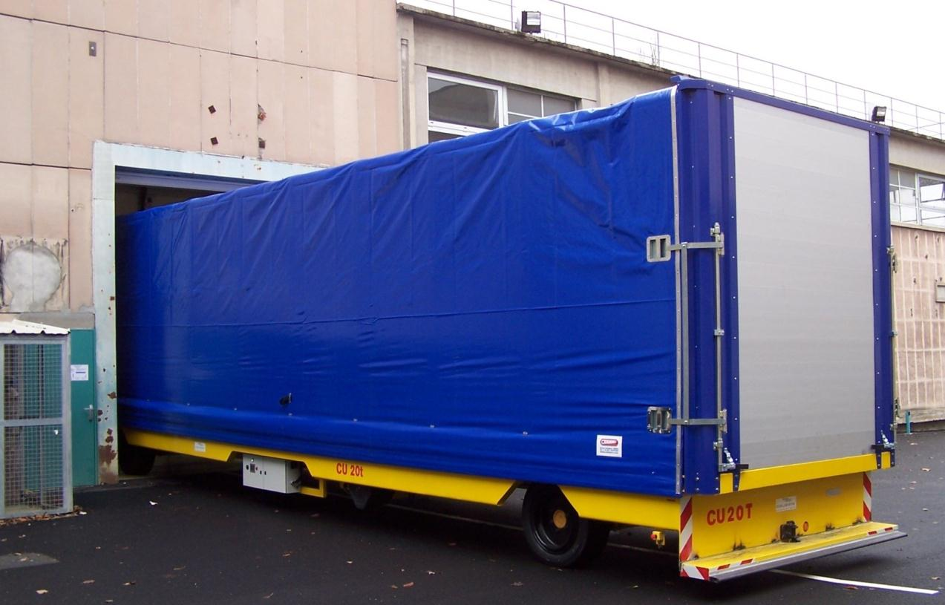
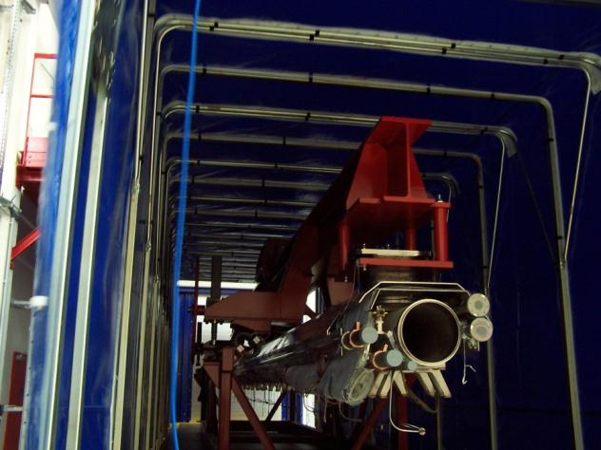
Cryomodule Transfer
The electrical transfer vehicle is fully operational.
Spares have been ordered for all critical parts (e.g. battery, etc…)

Slide 23
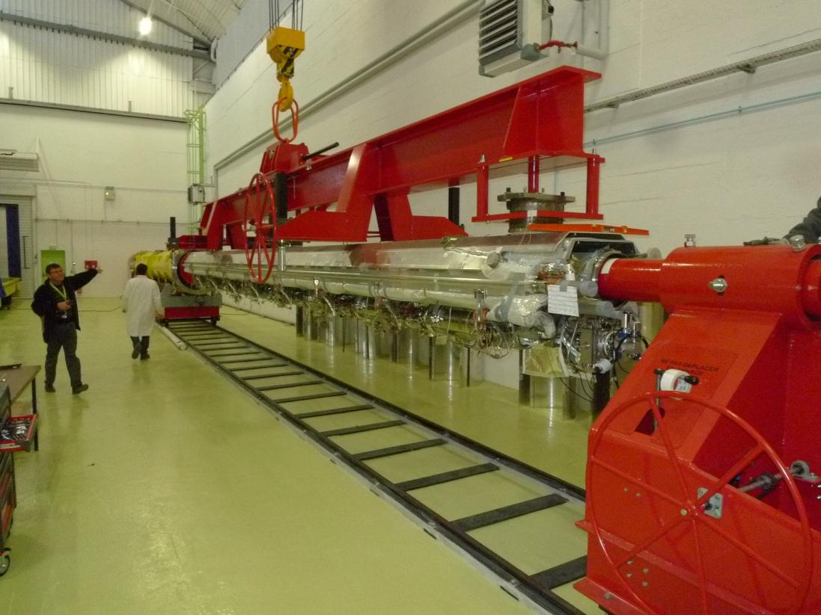
Assembly prototyping at Saclay
5. Cold Mass insertion (CA-WS1)

Slide 24
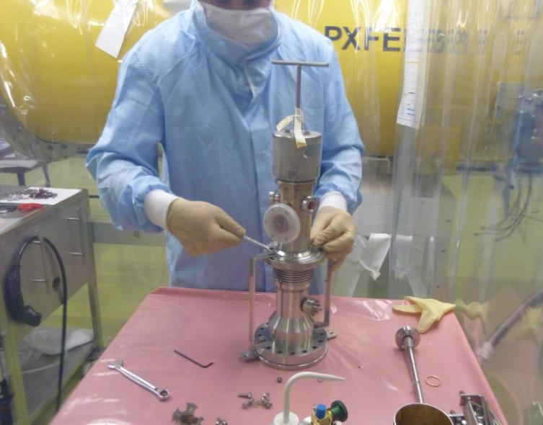
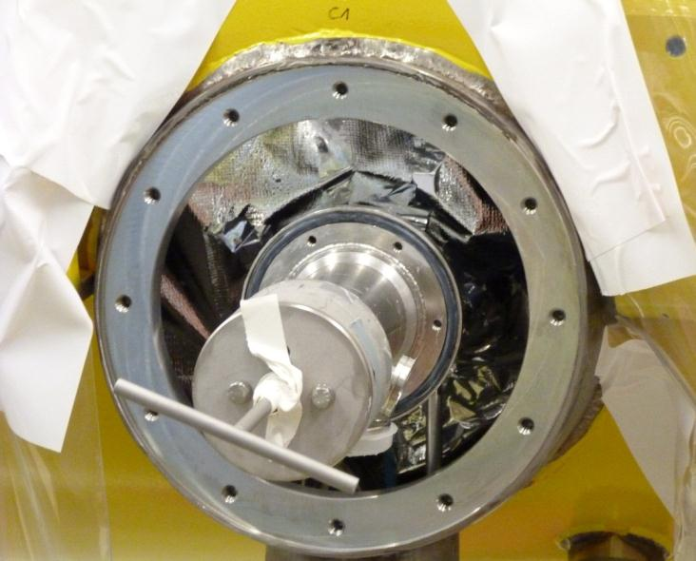
Assembly prototyping at Saclay
6. Coupler Warm Part assembly (CO-WS1&2)
6.a coupler warm part assembly
6.b coupler pumping line assembly

Slide 25
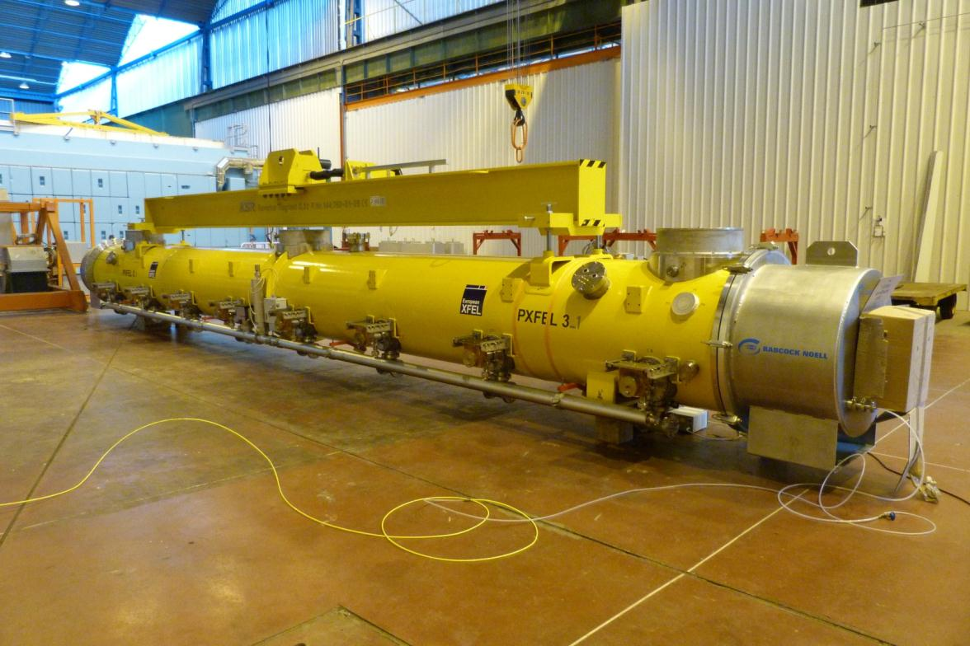
Assembly prototyping at Saclay
7. Final control and shipment (SH-WS1&2)

Slide 26
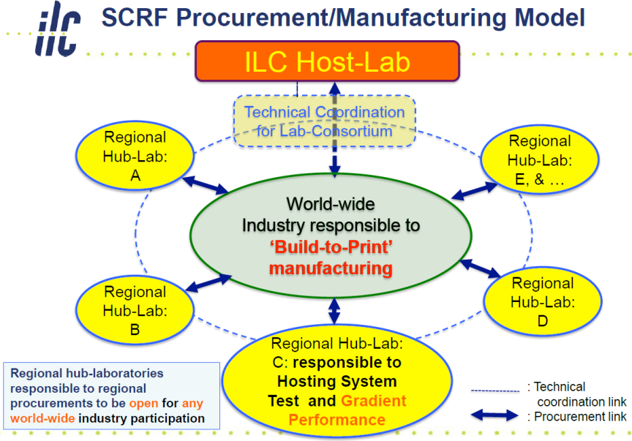
EU Hub’ for ILC cryomodule production
Production organisation in 3 regions
A. Yamamoto
For ILC 500 GeV
with ~2000 cryomodules:
The goal is to reach a production rate of
2 cryomodules/wk * 5 (3) hubs
→ 4 (7) years of construction
For XFEL 100 cryomodules :
1 cryomodule / wk.
Infrastructures do match the production rate of 2 CM/wk
Main challenges for Irfu-IN2P3:
Be a ‘Hub-Lab’ (ou ‘Tier 1’) for the infrastructures built for XFEL at LAL-Orsay and Irfu-Saclay
Close partnership with the french companies : Thales, Alcen/Alsyom, Aperam, Jehier, etc… et européens, RI, Zanon, BNG, Plansee, Heraeus, VAC.
Supprimer l’interface entre le LAL et l’Irfu pour les activités Coupleurs-Cryomodules

Slide 27
Assembly Industrialization
(reserve)

Slide 28
Challenge : Tooling vs. Ind^{ial} Contract
Ideally the tooling definition should be included in the industrial contract.
This was impossible with our project timeline and readiness: e.g. the clean room was delivered in Nov. 2009.
The contract specifies that the Industrial Operator is only responsible of the standard tools, while CEA is responsible for the specific tools and their maintenance.
The contract is essentially ‘Man and Engineering Power’
As a consequence, the industrial operator will criticize the infrastructure layout and the tooling made available to him:
e.g. cavity reception area,
e.g. cavity support and pre-alignment tools in the clean room,
e.g. layout of shipment vs. VV strorage area
Some of the criticisms come too early, missing the global scheme.
Some of the criticisms will lead to a better optimized production.

Slide 29
Input Data Readiness for Industry Transfer
14/11/2013
@ CfT Kick-off Prod
Infrastructure and Tooling 80% 90% 100%
(in the broad sense, e.g. cavity supports)
Cryomodule Configuration 70% 85% 100%
Cryomodule Documentation
  PBS (or MBOM) 30% 70% 100%
  Availability of Drawings 30% 70% 100%
Assembly Documentation (WBS)
  Availabitity of Assembly Procedures 50% 75% 100%
  Availabitity of Control Procedures 50% 75% 100%
  Availabitity of Regulation (PED, Safety) 20% 75% 100%
(qualitative %)
Ideally, all ratios should be 100 % (cf. cavity production, or AMTF).
Industry cannot start production w/o 100% of Input Data in their Resource Planning software (ERP)
Overall Quality of the Process (RF acceptance) 60% 60% 100%

Slide 30
Selection of Industrial Contractor
Tender process: ALSYOM, lowest bidder / best technical offer, has been selected by CEA.
Up to 29 people will be on Saclay site during ~2 ½ years
Fields of expertise requested:
  Management (resource planning, stock, quality)
  Engineering (method, drawings, tooling)
  Clean room and cleaning
  Vacuum
  RF
  Welding
  Survey
  Mechanical operations

