Slide 1
Laser-electron beam interactions group activities

Slide 2
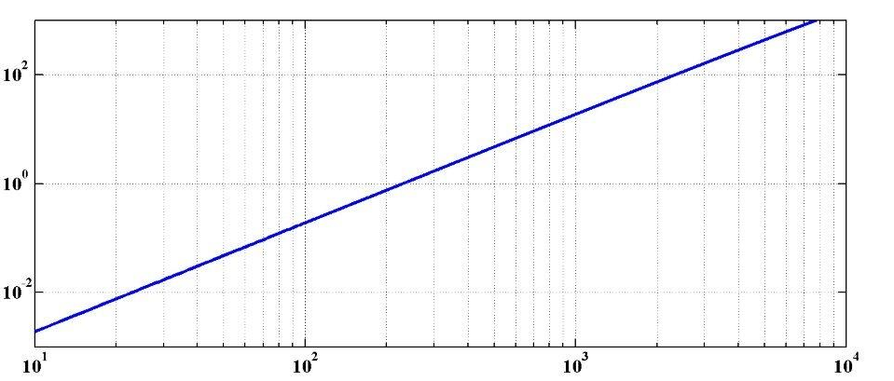
Applications of Compton scattering
e⁻ beam+ laser → e⁻ + X/γ ray
Ε(X/γ) MeV
λ_{laser}=1μm
γ ray 100 MeV
Mighty
Laser
(POSIPOL)
ELI-NP
γ ray  1MeV
ThomX
X ray  10-100keV
E(e⁻ beam) MeV
E_{e}20-100MeV
E_{e} 100-1000MeV
E_{e} 1GeV
Low energy applications
Medical:
radiography &radiotherapy
Museology …
Nuclear fluorescence
applications
Nuclear physics
Nuclear survey
Nuclear waste management…
High energy applications
  Compton polarimeter
  γγ collider
  Polarised positron
  source…
2

Slide 3
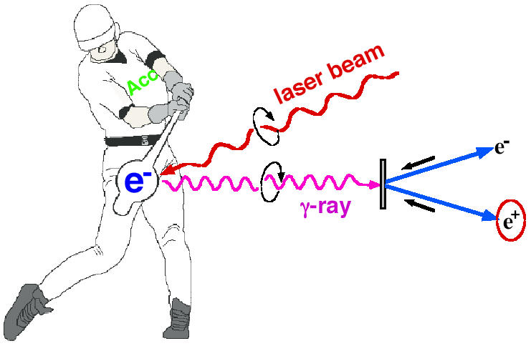

Introduction to POSIPOL (MightyLaser)
Polarized e+ by laser Compton Scheme for ILC/CLIC
Ee~1GeV for 10MeV gammas
easy to control polarization
Biggest issue:
The laser beam power…
➔ R&D effort
Toward the positron sources
-> increase intensity of gamma rays
Courtesy of Omori-san

Slide 4
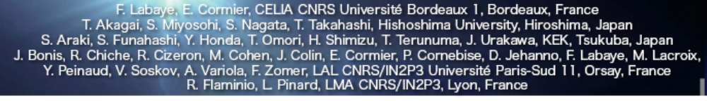
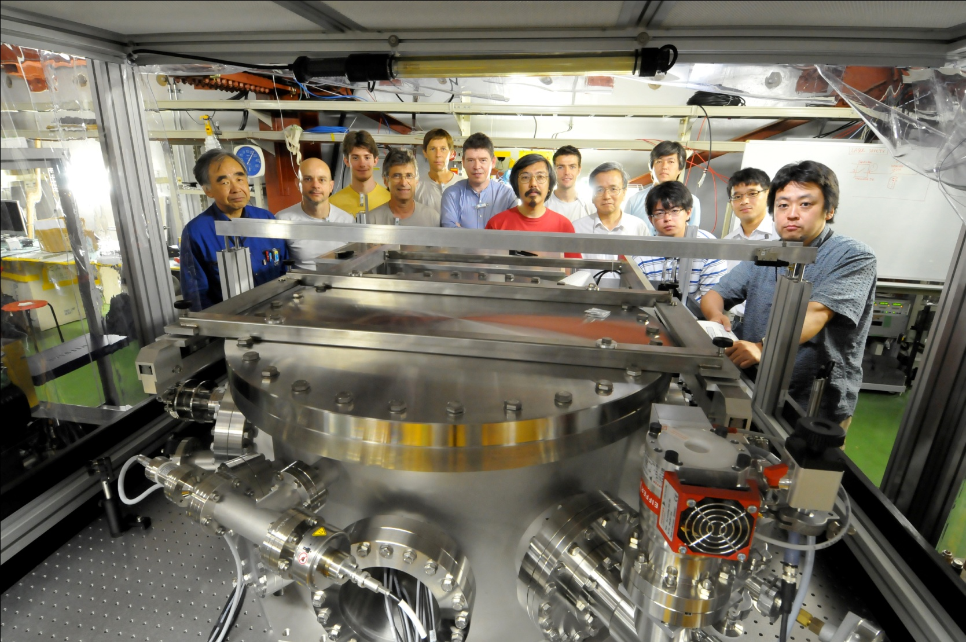
MightyLaser
French Japanese Collaboration
(close work, regular meetings since 2005)
K. Cassou
Y. Chaikovska
N. Delerue
A. Martens
P. Favier
Araki-san

Slide 5

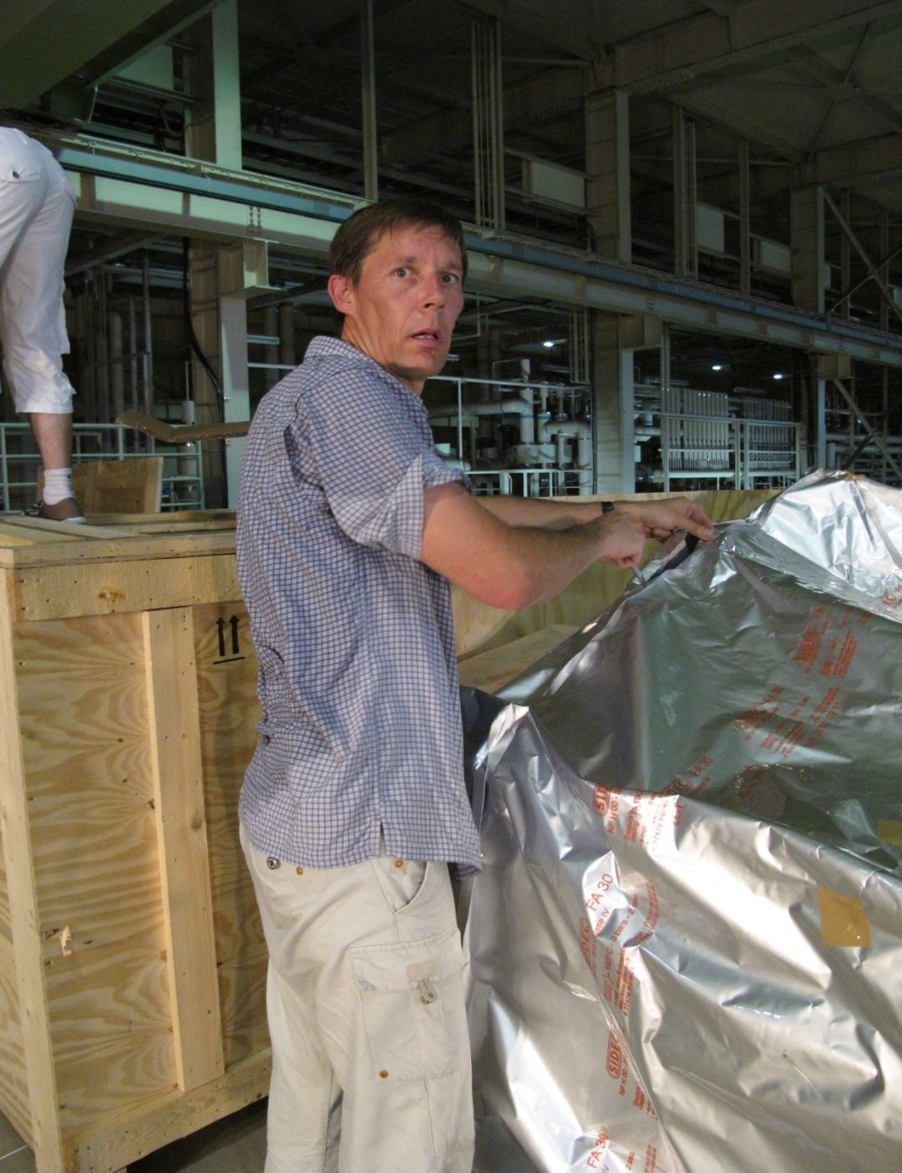
Boxes opened
26 july 2010
Total weight
~3 tons
37°C in the
ATF hall !

Slide 6
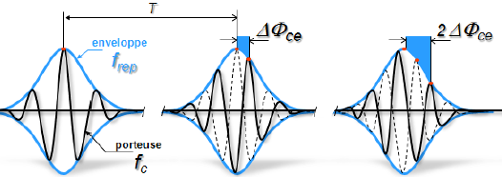
MightyLaser 2008-2013 (R&D setup 2013→)
High flux quasi-monochromatic X/γ ray Compton sources
electrons
T
2ΔΦ_{cep}
T_{e}
ΔΦ_{cep}
femtosecond
Oscillator
(40-200MHz)
High average
power
amplifier
Optical
cavity
T_{R}
Feedback system Δν/ν  10⁻¹²
+ synchronisation
(➔metrological techno.)
X or γ rays
collimator
Quasi monochromatic
X or γ rays
Goals: stack as much average power as possible in an optical resonator➔1MW
& produce high flux of circularly polarized γ-ray at ATF/KEK

Slide 7
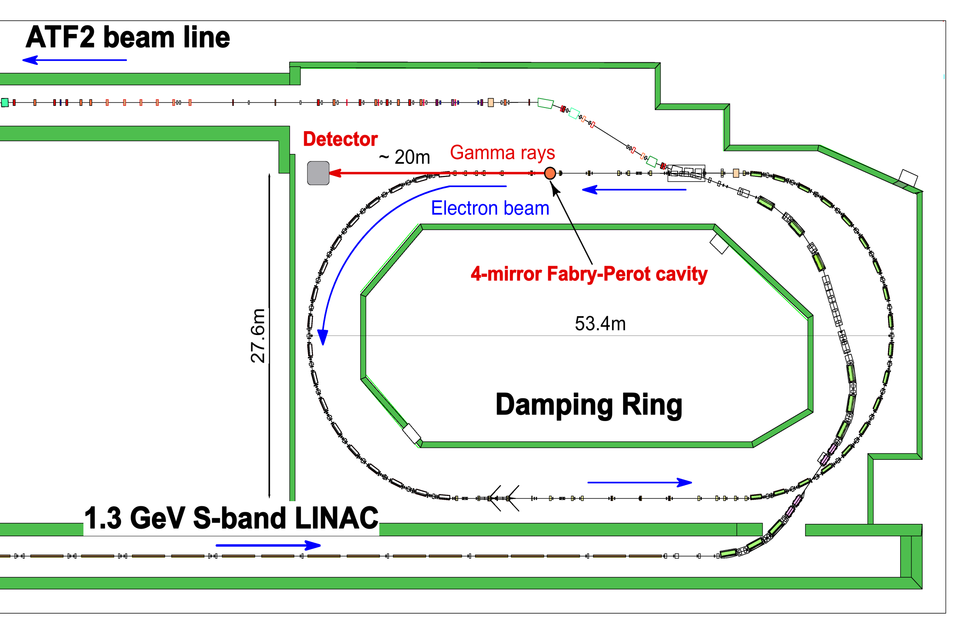
Compton Experiments at ATF
French and Japanese Cavities
γs
Cavity
Highest γ-ray flux
obtained fall 2013
1.3GeV
up to 10 bunches/train

Slide 8
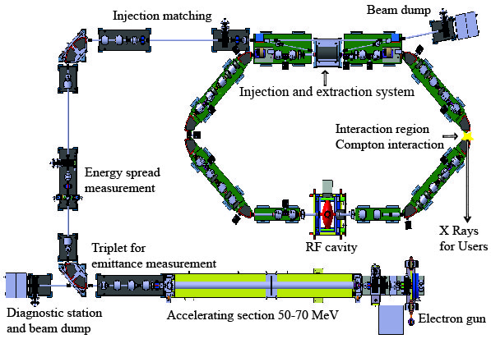
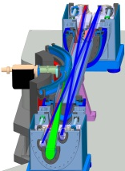

Future: ThomX
Cycle Frep = 20 msec
RF pulse length 3 μs
Energy 50 - 70 MeV
Laser
and FP cavity
2 Ips
Easy integration
Frees the straight sections
CSR line
~7m
~10m

Slide 9
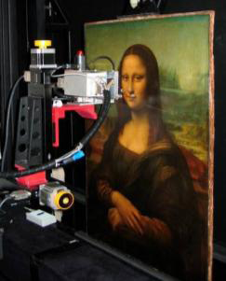
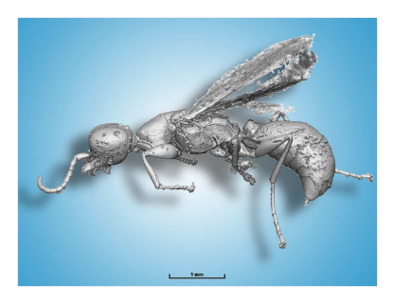

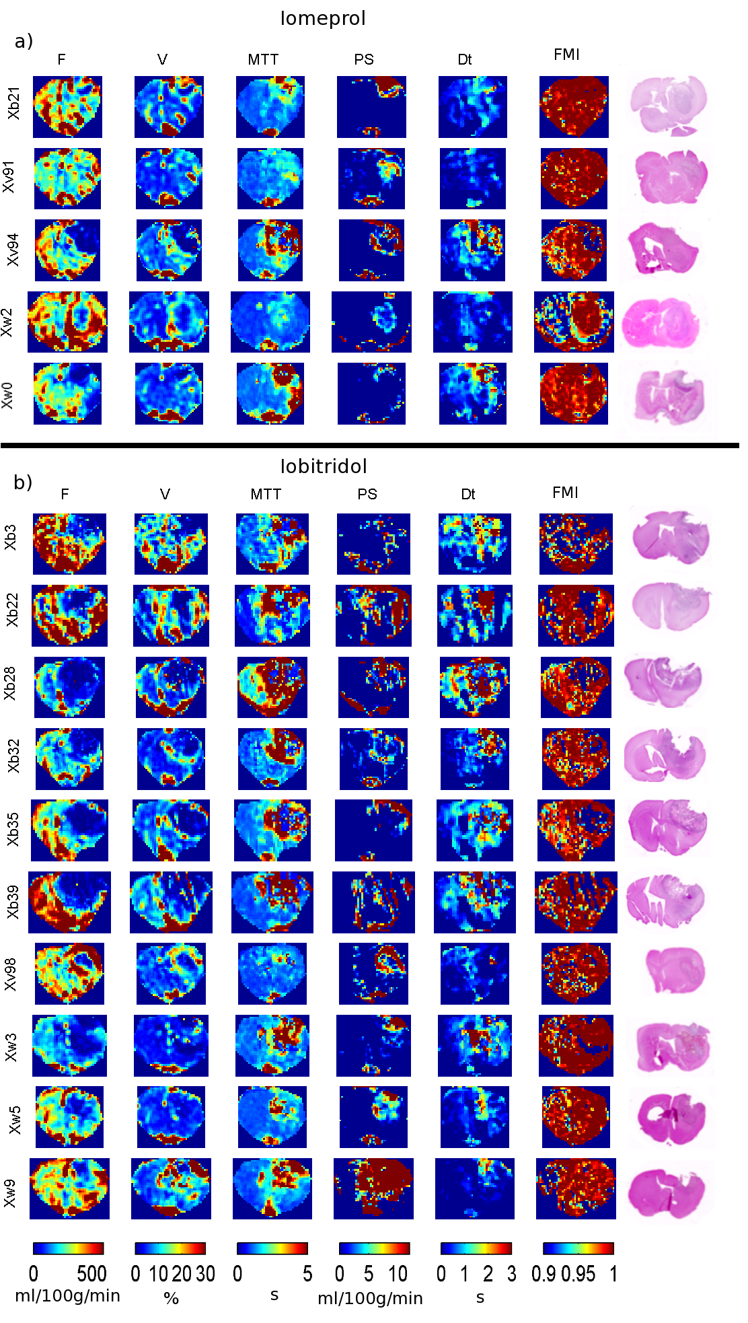
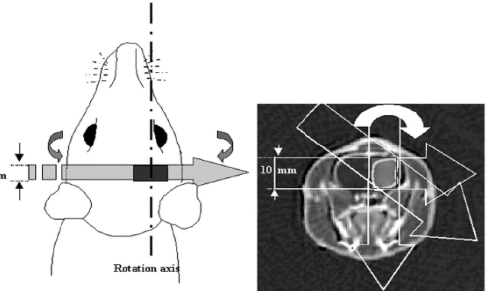
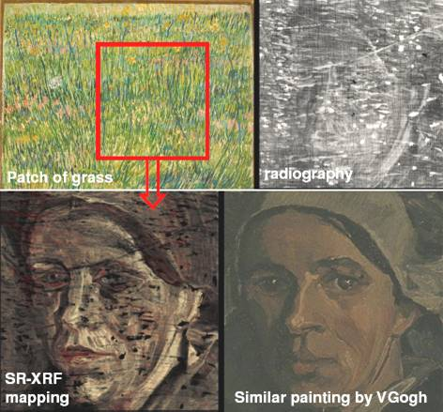
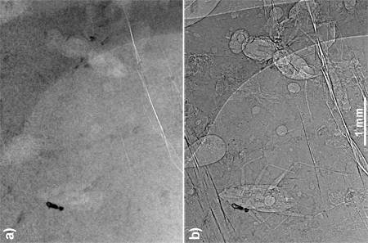
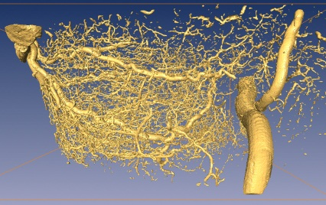
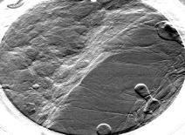
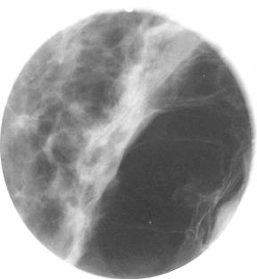
ThomX: a machine turned toward societal applications
Transfer of the SR techniques to these new machines. Many fields can be interested…
At present two contributors: *Medical field (ESRF, INSERM Grenoble) *Cultural Heritage (C2RMF CNRS – Louvre Museum)→
LAMS(Archeology Labs.)
K-edge imaging
Phase contrast imaging
Physiopathology and Contrast agents,
Dynamic Contrast Enhancement SRCT
Convection Enhanced Delivery =>Stereotactic Synchrotron RT
Paleontology
Non-destructive analysis
Imaging,
Mammography
Microtomography
Biston et al, Cancer Res 2004, 64, 2317-23
K-edge imaging (Pb➔white, Hg➔ vermilion…) of a Van-Gogh’s painting
J. Dik et al., Analytical Chemistry, 2008, 80, 6436
  J Cereb Blood Flow and Metab, 2007. 27 (2):292-303.
Journal of Radiology 53, 226-237 (2005)
Acknowledgments to G.Le Duc, P.Walter

Slide 10
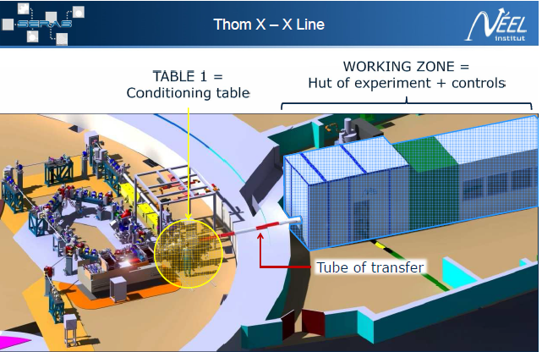
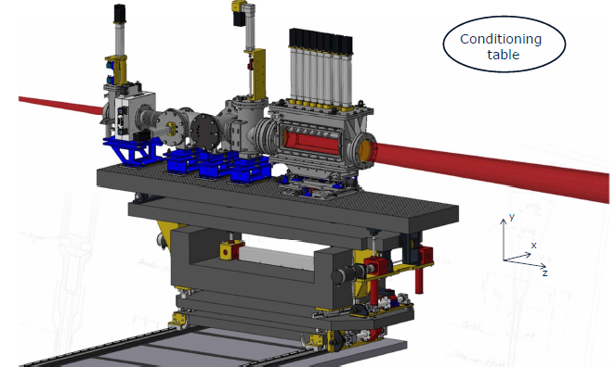
X-ray line for
performing X-ray
experiments
Fully funded, under construction since 2012
Commissioning expected beginning
2016

Slide 11


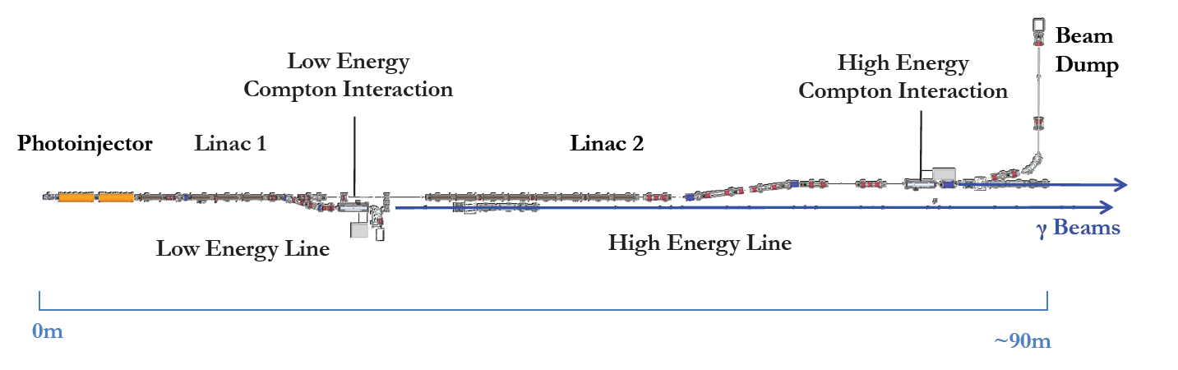
ELI-NP γ-ray beam
(European answer to a EC tender)
& entreprises
Alsyom
Amplitude
Comeb
Scandinova
S&C band 700MeV e⁻ LINAC with 2 Compton IPs➔Bucarest
(Nuclear applications)
High flux, small bandwidth γ-ray beam
(~100 better than state of the art)

Slide 12
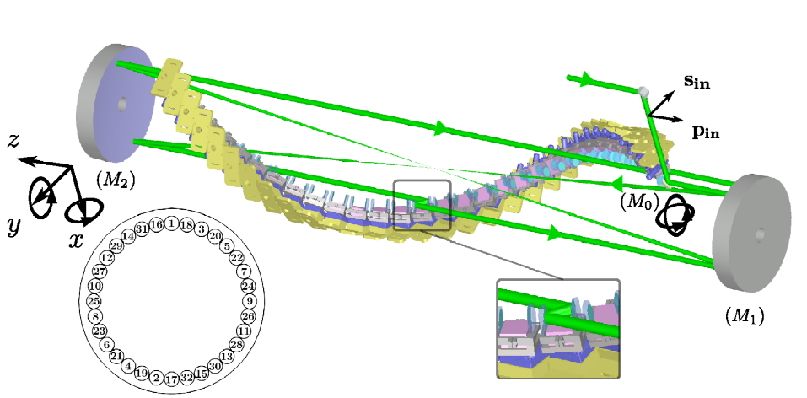
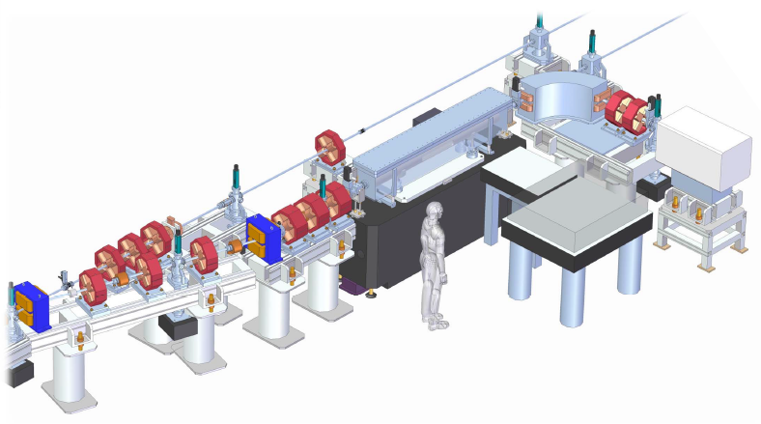
LAL contribution to ELI-NP
Design, alignment, synchronization, commissioning of a 32-pass 3D recirculator
➔High precision ‘aberration free’ optical setup
<100fs synchronization
Tolerances & cleanliness & damage
issues similar to Laser Mega Joule
➔Close collaboration with
ALSYOM CO. in charge of manufacturing ,
optical pre-alignments, installations
30cm
Contract signed
in march 2014
Work → up to 2018
(LAL has the responsibility
of the optical systems)

Slide 13
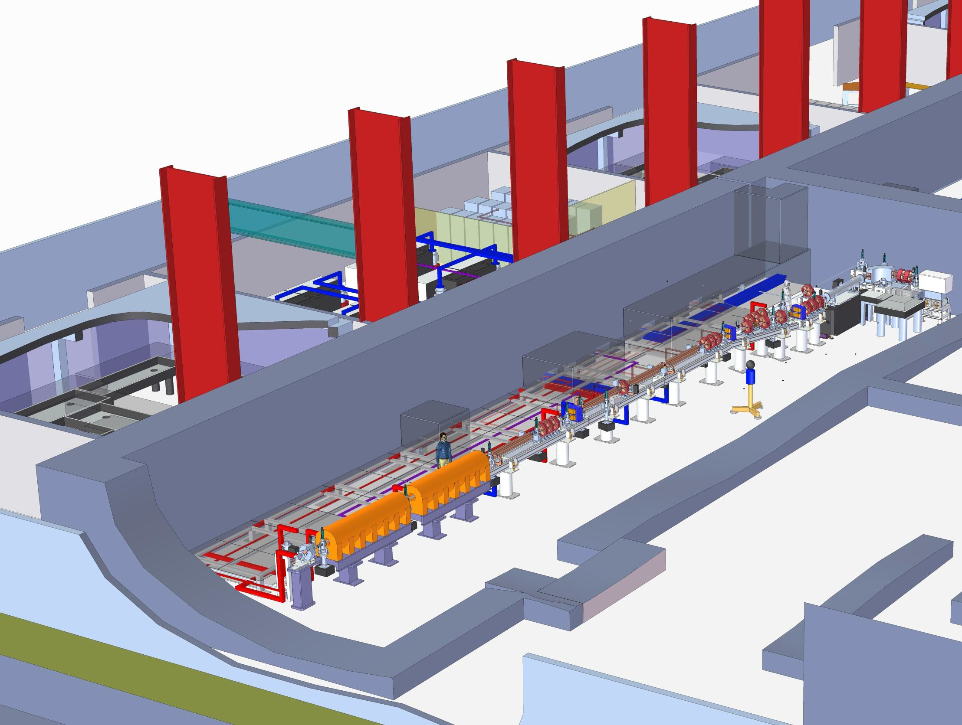
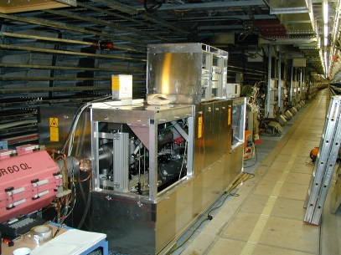
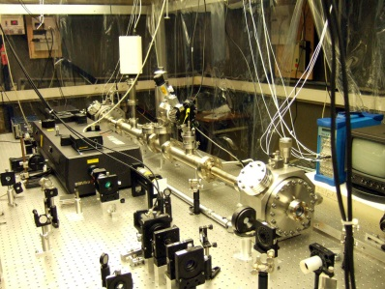
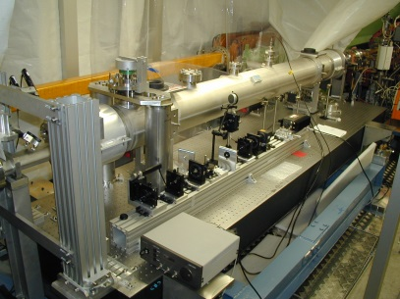
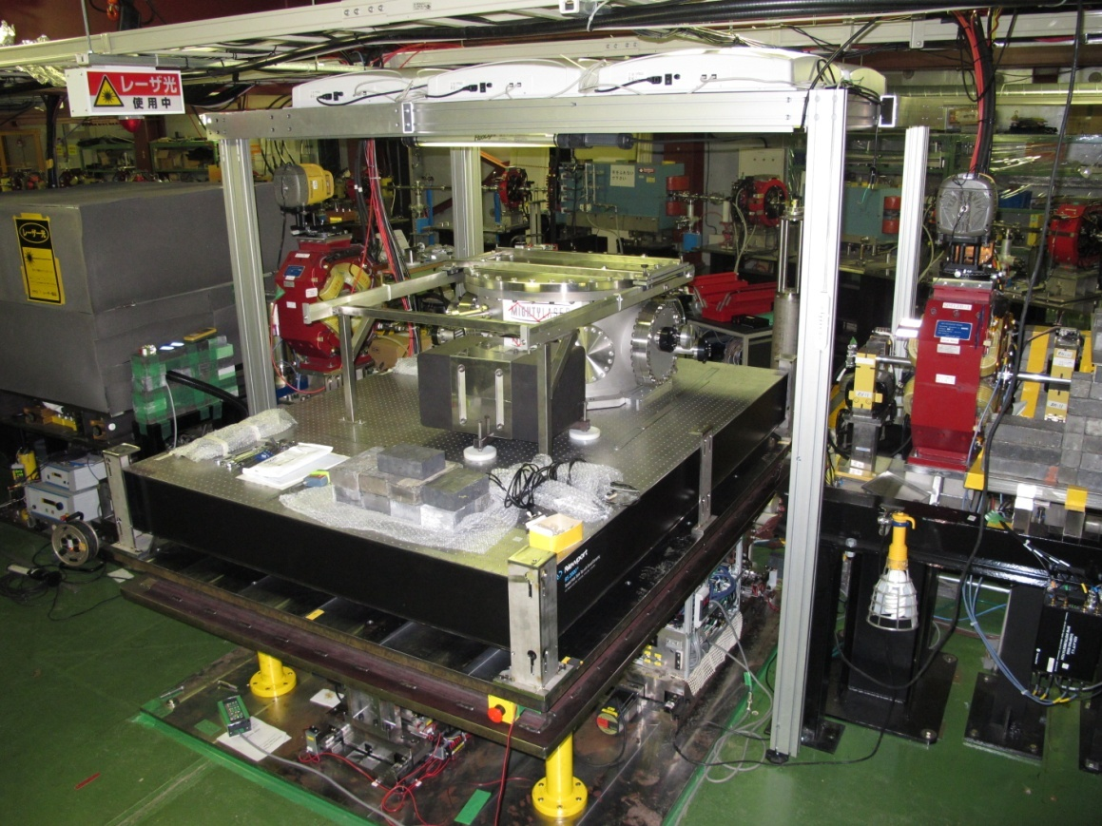
Summary
Past
Present/futur
HERA/Desy
Compton
Polarimeter
2000→2004
Orsay
R&D polarized
positron source
2004→2007
ATF/KEK
MightyLaser
R&D polarized
positron source
Orsay
ThomX
Romania
ELI-NP-GS
R&D on high finesse cavity High average laser
power optomecanics, Compton interaction exp.
➔world best finesse in ps & 200fs regime
➔R&D to be continued to reach 1MW…
Creation of the LAL Accelerator Dpt.
➔Accelerator projects built around
high finesse cavity and optical
recirculator

